Slide 1
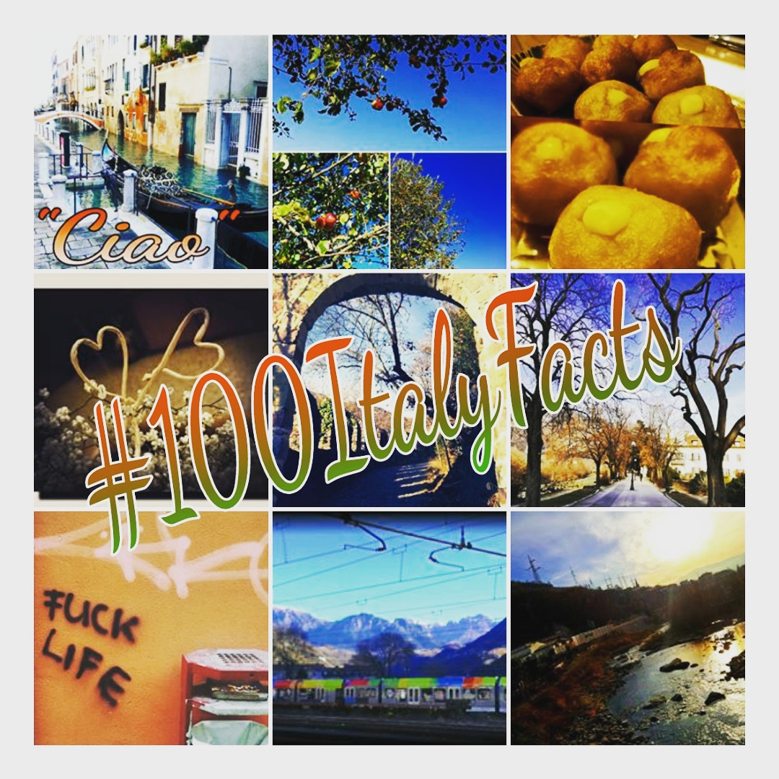
The Collection

Slide 2
Curios facts about Italy originally posted on Instagram
By
fka_sara

Slide 3
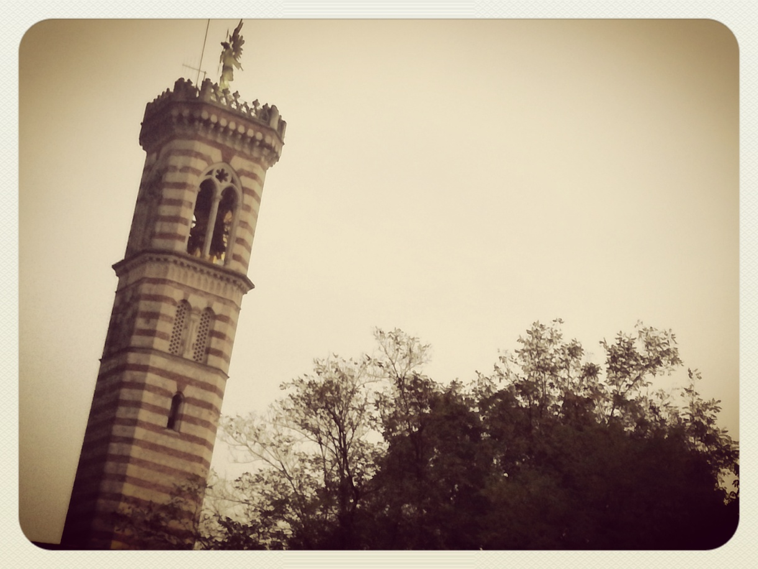
Day 1
You can often find a statue of the Archangel Michael on top of Italian bell towers: as he represents the leader of all angels, he is put there to protect the city. But the statue has also a secular function: it serves as a weathervane. The one on top of Saint Mark bell tower in Venice, for example, can predict high tides.

Slide 4
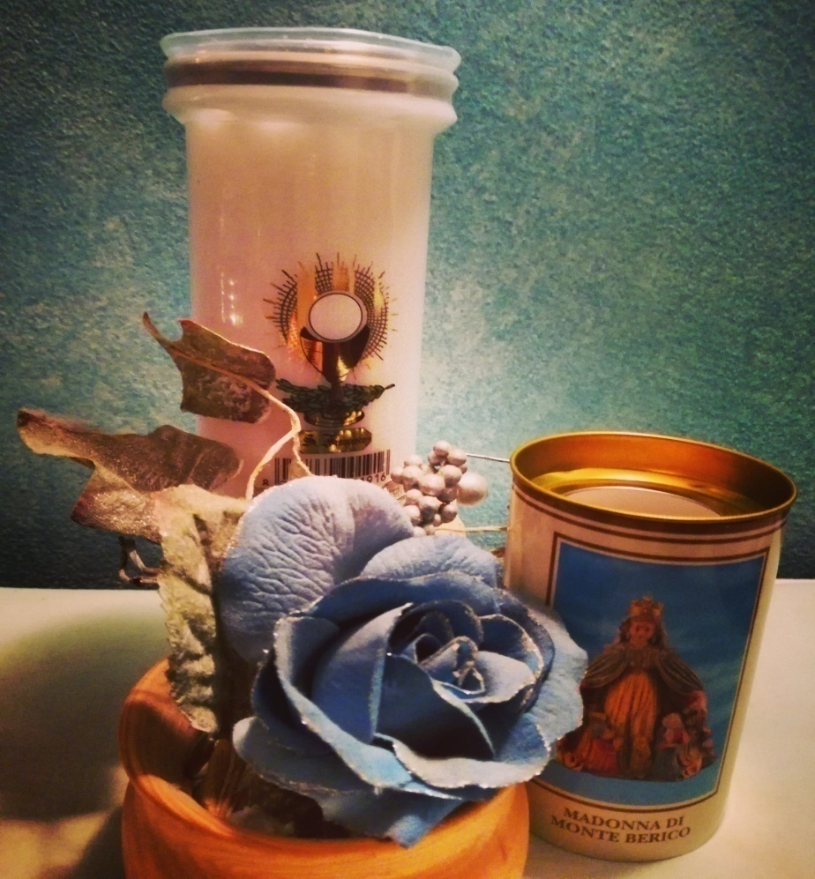
Day 2
The 2nd November is officially the Day of the Departed Souls. All the believers visit the graves of the dear ones in the cemeteries and light a candle for them. The candles are usually decorated with images of popular saints like St. Francis and Saint Pio of Pietrelcina. The one you can see on the right shows the image of The Virgin Mary of Mount Berico, the patron of Vicenza, my city.

Slide 5
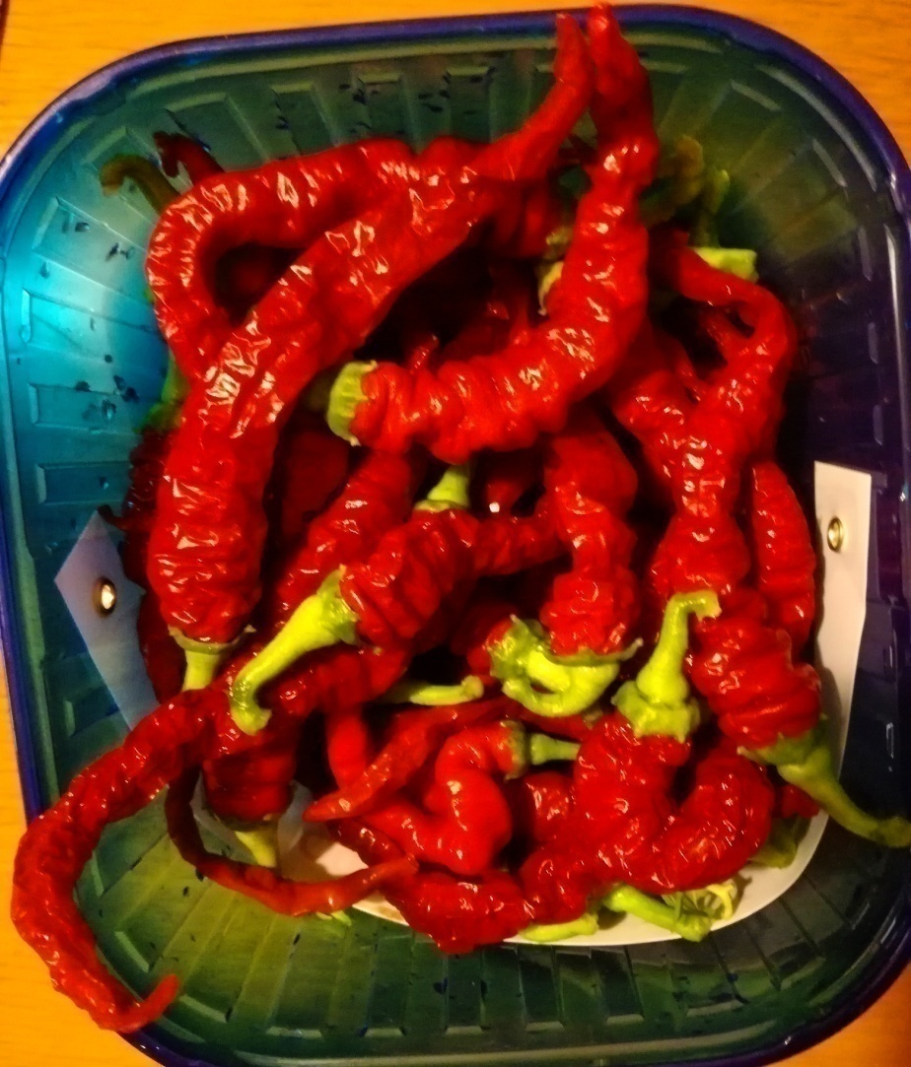
Day 3
Chili peppers are believed to be aphrodisiac and to keep away bad luck. In Southern Italy it is not unusual for farmers to put a "plait of chili peppers" outside their homes.

Slide 6
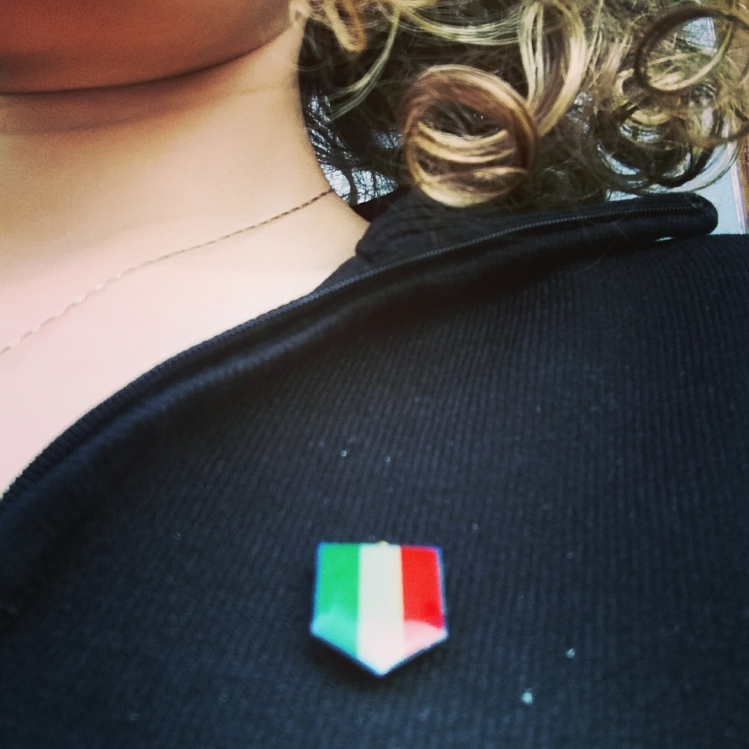
Day 4
The 4th November is officially the Day of the Armed Forces in Italy. You won't see many flags around the country, though, as it is basically only used to celebrate gli Azzurri, our National Football Team.
The Italian flag was inspired by the French one and a specific meaning for each colour was attributed only in a second moment. GREEN for hope, WHITE for faith, RED for love.

Slide 7
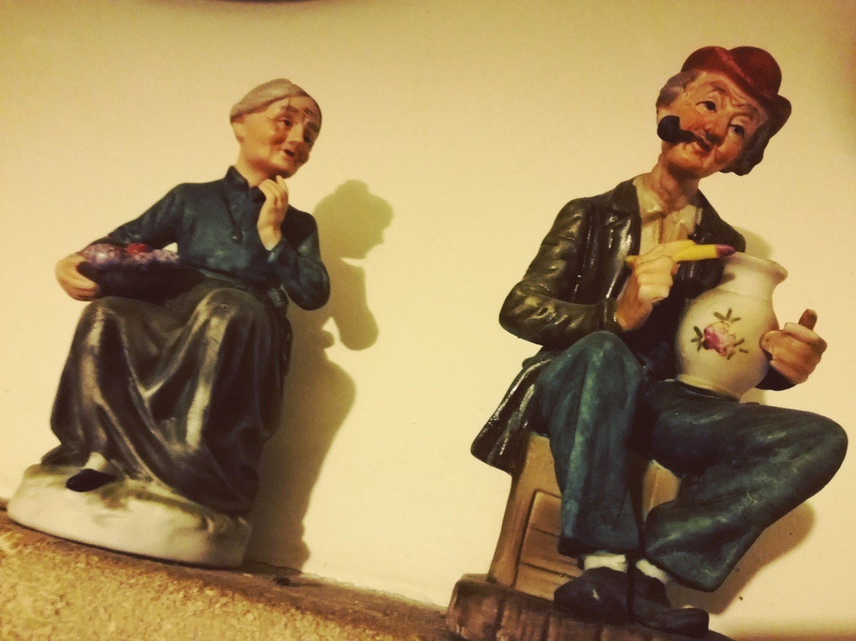
Day 5
Grandparents, in Italian "nonni", play a fundamental role in Italian families and in a society where the elderly are highly regarded. They often take care of grandchildren, as in Italy we lack public kindergartens and the private ones are way too expensive.

Slide 8
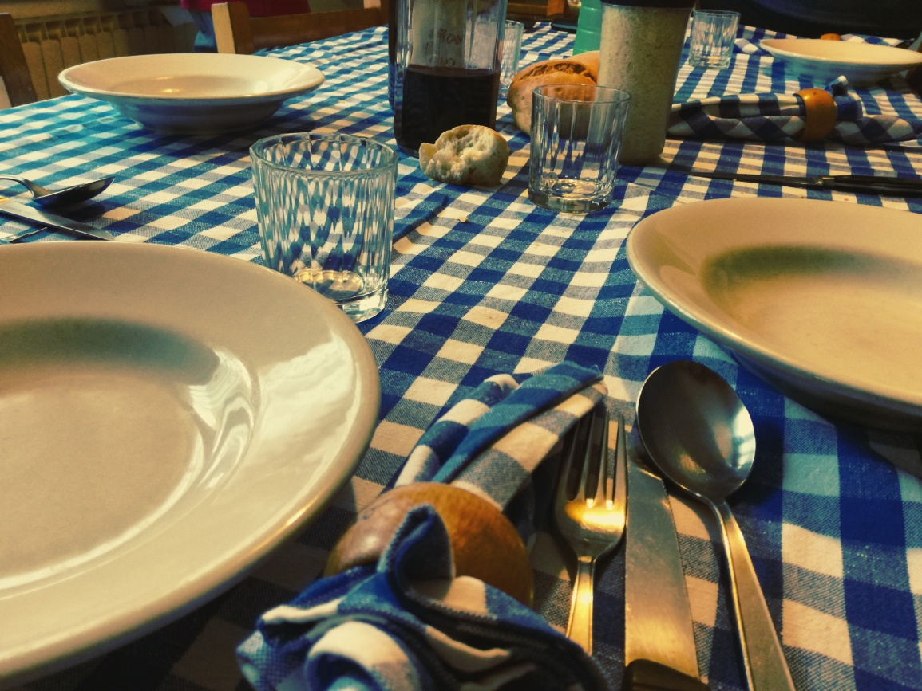
Day 6
Setting the table and eating together is a custom Italian families still preserve. Meals do not involve only eating, they are a social event. Families eat together as much as they can: if they live apart and do not stay together during week days, they gather for the Sunday lunch.

Slide 9
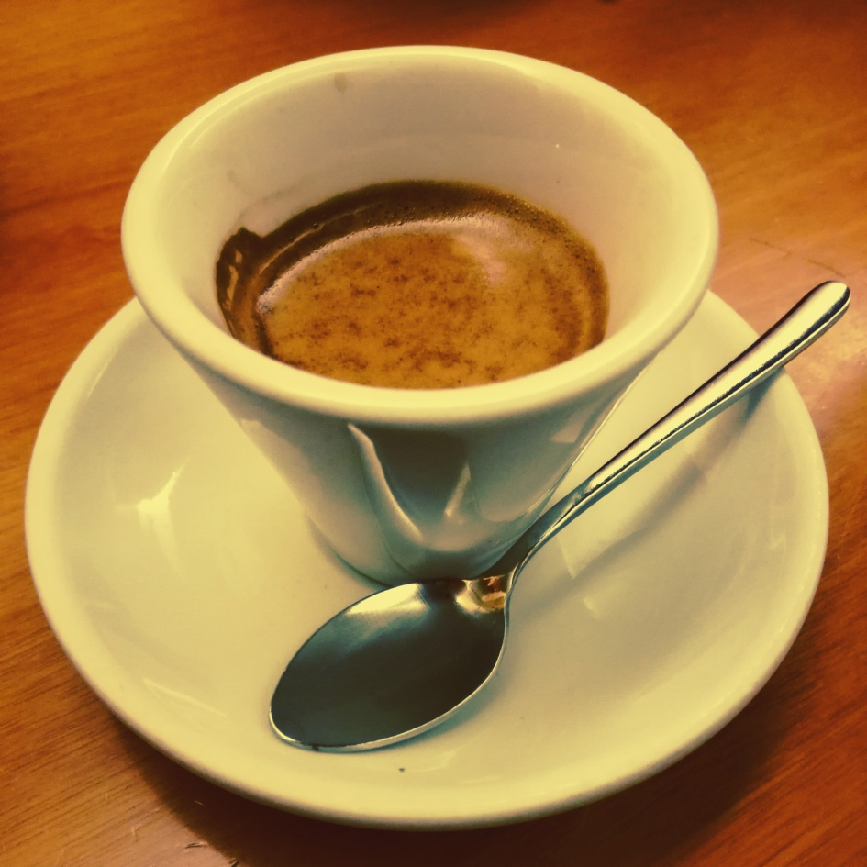
Day 7
This is how a "diluted" espresso looks like for an Italian! Giant cups of coffee usually sold in the rest of the world taste like water for us!
If you want a diluted espresso when in Italy, ask for a "caffè lungo" (literally "long coffee"). ☕

Slide 10
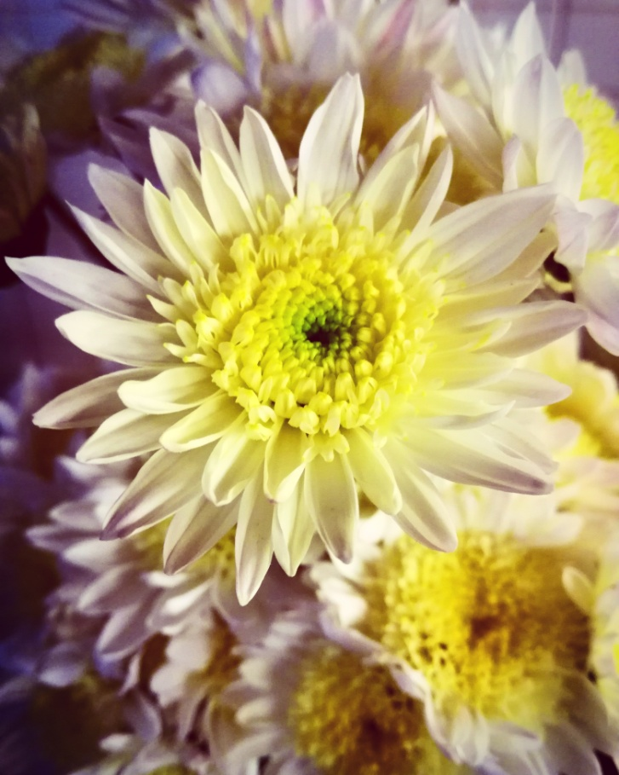
Day 8
This flower reminds me of a funny story my British professor once told me: when he was a young student and he was in Italy for a cultural exchange, he bought a bunch of these flowers for the mother of an Italian friend who invited him for lunch. The woman, much to his disbelief, shuddered with horror.
Moral of the story: never gift an Italian woman with chrysanthemums. In Italy they are the flowers to be put in front of the gravestones!

Slide 11
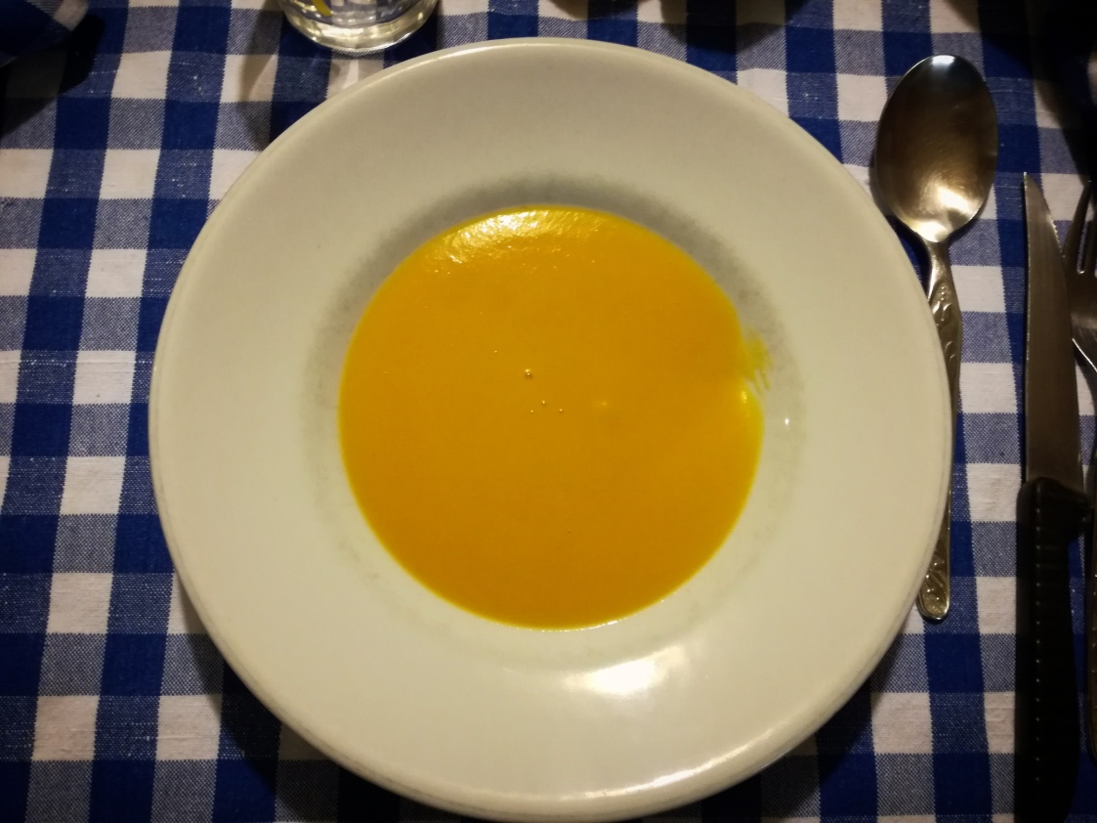
Day 9
Halloween does not belong to the Italian tradition, only in recent times they have tried to introduce it to kids for commercial and profit-making reasons. For Italians, though, the only sensible use of a pumpkin is the one with: - water; - milk; - flour; - sugar, eheh.

Slide 12
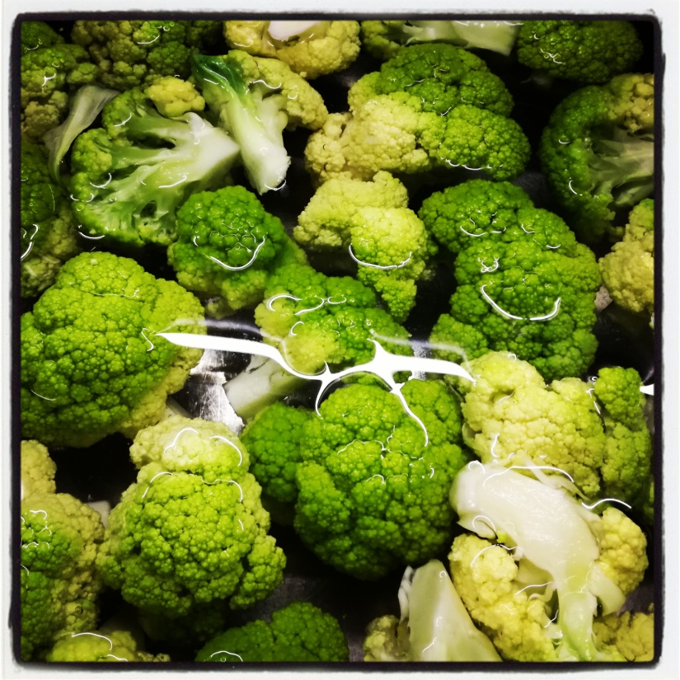
Day 10
Food is a serious matter in Italy and every grandma is constantly worried her beloved grandchild isn't eating enough. I'm quite sure every single Italian, that in his childhood turned his nose up at vegetables, heard at least once her grandma saying to him: "Eat everything, think about the African children who are starving!" This is surely one of the most famous (and dreaded) sayings among grandmas and children.
While during childhood people dismiss this motto, when grown-up I guess they realize (or should realize) we live in a very rich country concerning food and variety of fruits and vegetables.

Slide 13
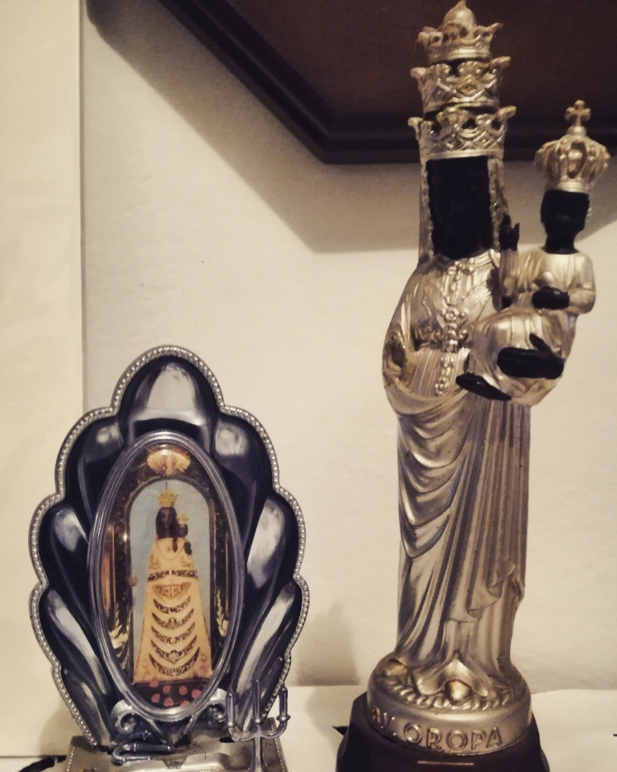
Day 11
Among Italian Catholics it's quite common the cult of the Black Madonnas. The one on the right is The Black Virgin of Oropa located in the Sanctuary of Oropa, in Piedmont (North-Western Italy). The one you can see on the left is the Virgin of Loreto, which is in the Basilica of the Holy House of Loreto (Central Italy). In this Basilica it is also preserved the house the tradition indicates as the one where the Virgin Mary lived in Nazareth. According to the tale it was carried there by angels through the air; historians say it was brought in Loreto by a noble family during the Crusades.

Slide 14
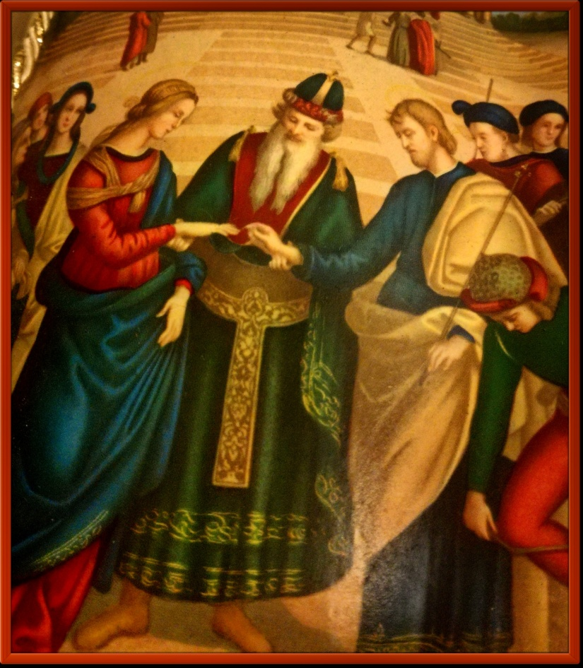
Day 12
Despite being a Catholic country, as it is the seat of the Roman Church, Italy does not have a high number of churchgoers. Even the number of religious marriages has considerably decreased.
[ In the picture a detail of The Marriage of the Virgin by Raphael]

Slide 15
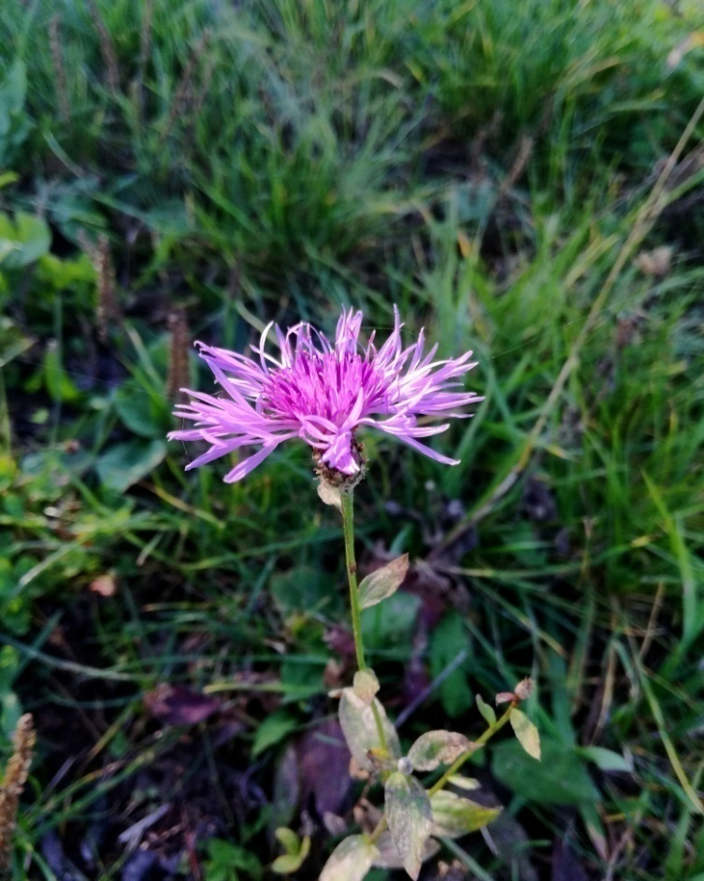
Day 13
When you'll watch TV or you'll be at theatre, you'll never see Italian men or women wearing purple on stage: in showbiz it is considered a colour that brings bad luck.

Slide 16
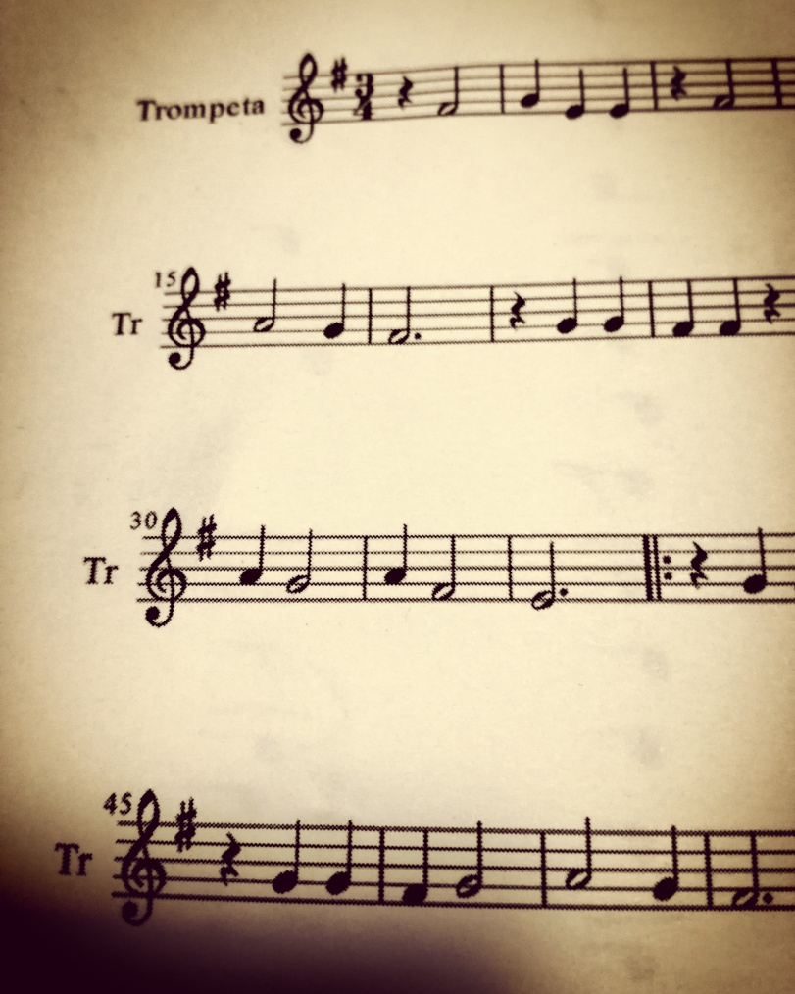
Day 14
Italian is considered a "musical and melodic language", basically because it's full of vowels and lacks truncated words. But it's also true that, as we officially invented the modern musical notation, we structured music on the basis of our language

Slide 17
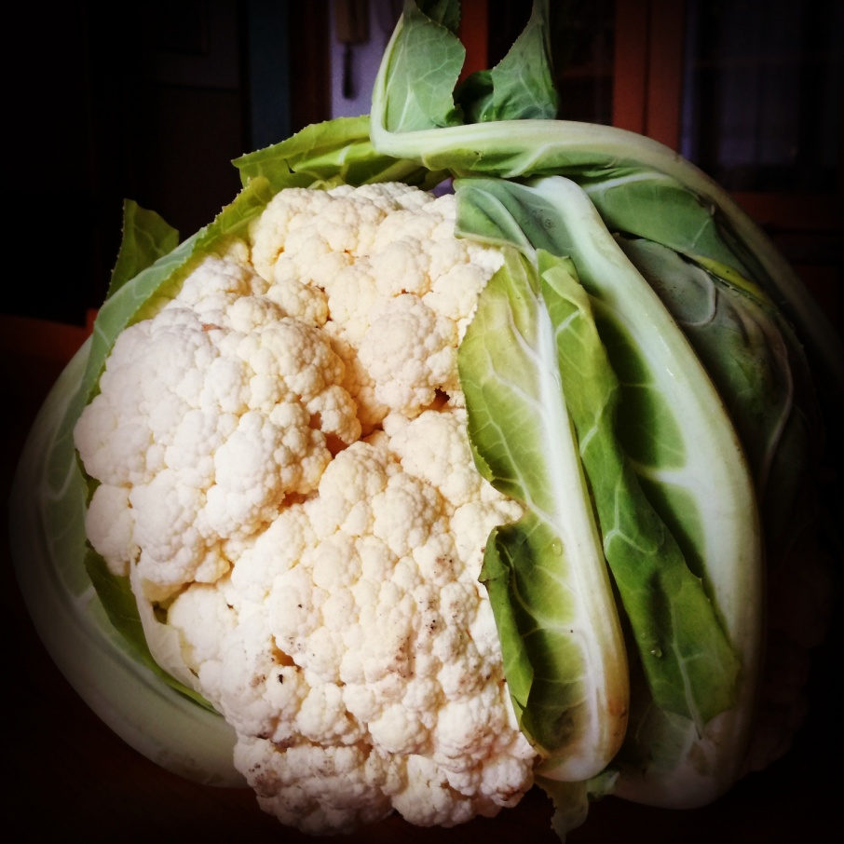
Day 15
We can be more vulgar than this, but when we have to tell someone we think they don't understand anything, we usually say: "You don't understand a cauliflower/cabbage" (this sounds so weird in English).
Feat. Dad's World-record cauliflower

Slide 18
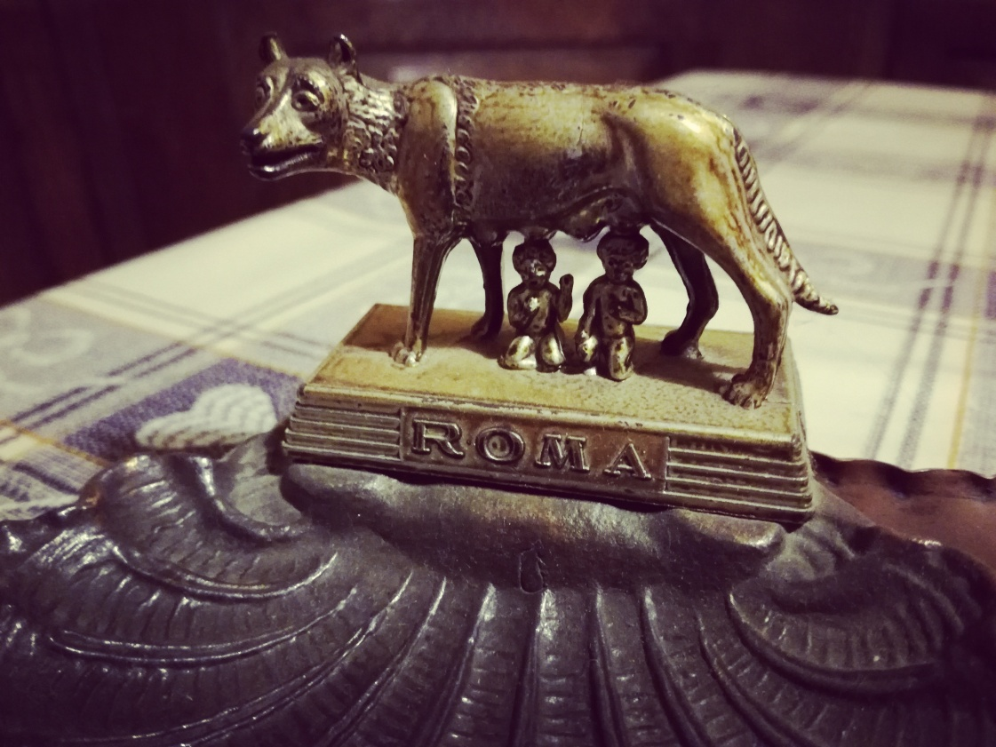
Day 16
According to the legend, Rome was founded by the twins Romolo and Remo who were abandoned in a basket on river Tevere and found by a she-wolf.

Slide 19
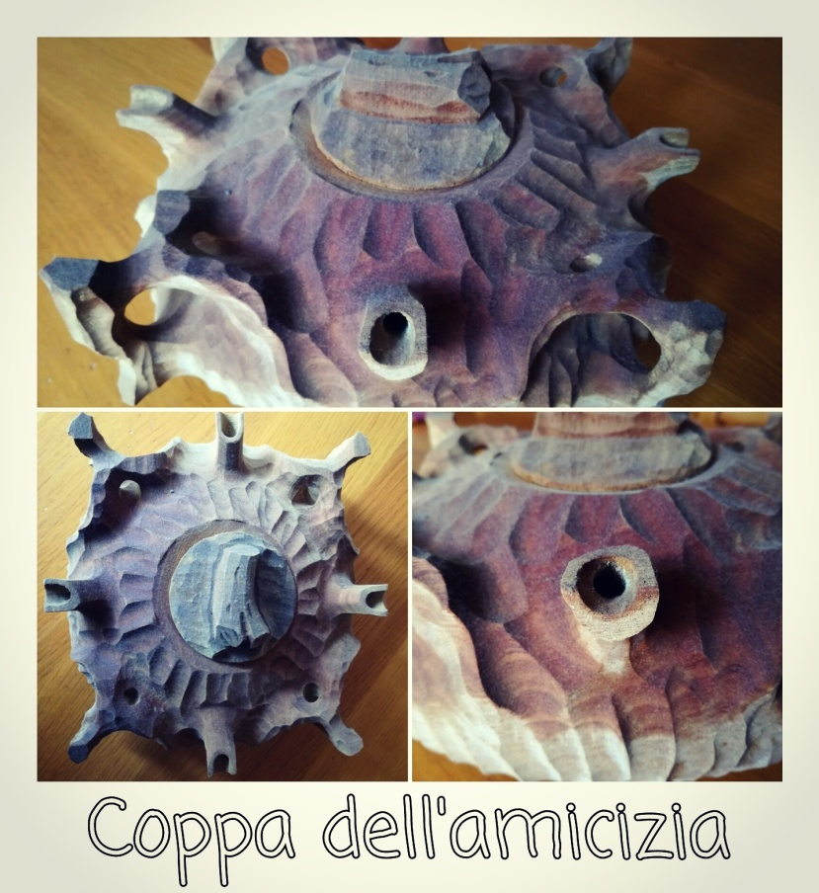
Day 17
“Coppa dell'amicizia" (literally "cup of friendship") is a wooden bowl which is typically from the Valle d’Aosta region in North-Western Italy. People fill it with a really alcoholic coffee and share it with friends or family: each person drinks from a different spout ☕🍷

Slide 20
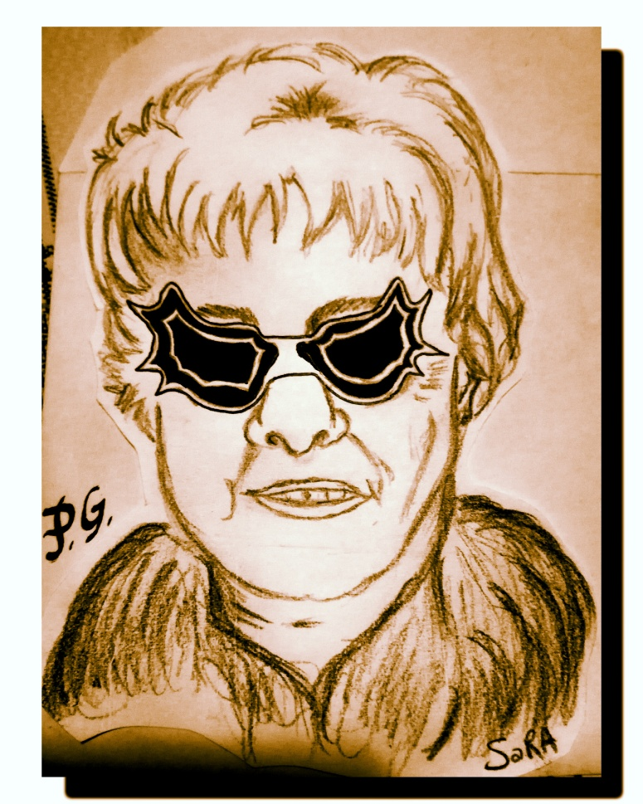
Day 18
Peggy Guggenheim was the last person to have a private gondola and gondolier in Venice.

Slide 21
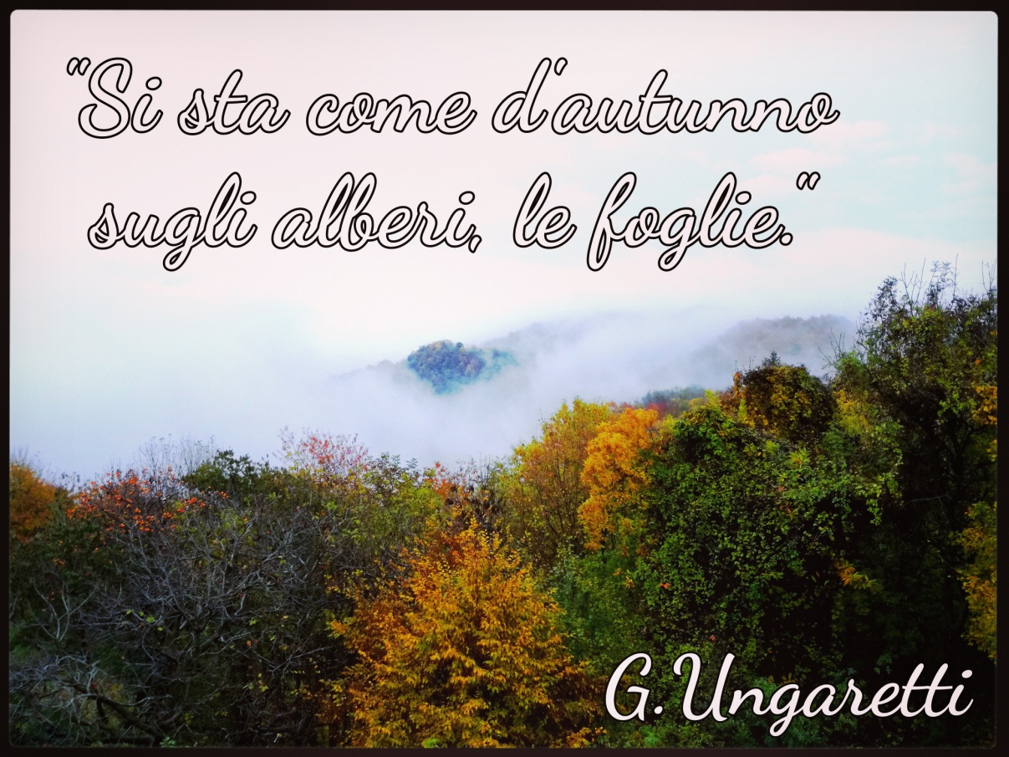
Day 19
In middle and high school, during the lessons of Italian literature, students are often required to memorize poems. The most beloved poem of Italian students is Soldiers by Giuseppe Ungaretti: "Here we are like leaves
from trees in autumn" 🍁🍂 Ungaretti compares the lives of WW1 soldiers to the autumnal leaves: destined to fall down and die.

Slide 22
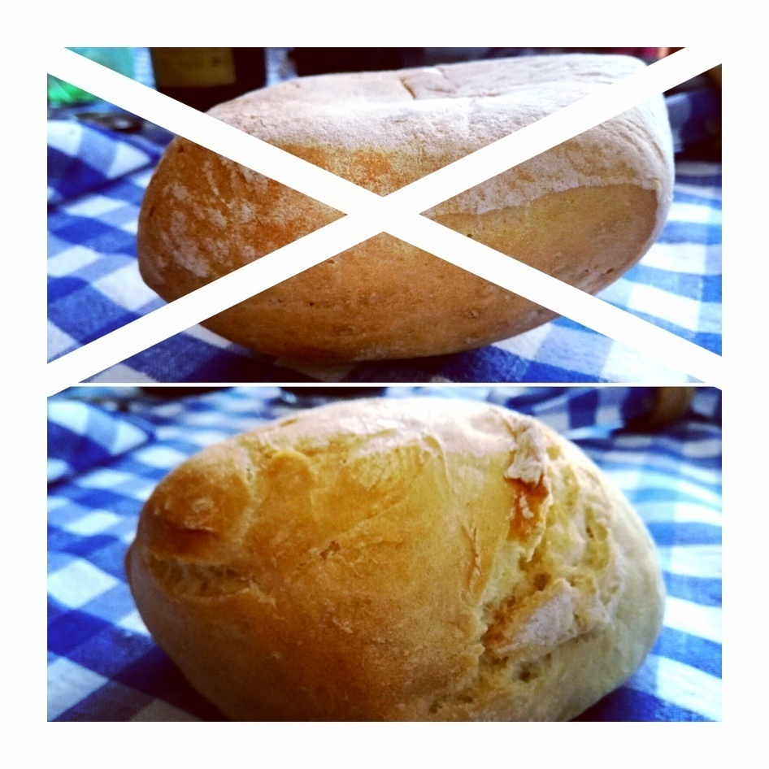
Day 20
When setting a table, never put the bread upside down! Since for Catholics bread is the symbol of Christ, our grandmas taught us never to disrespect Jesus Christ!

Slide 23
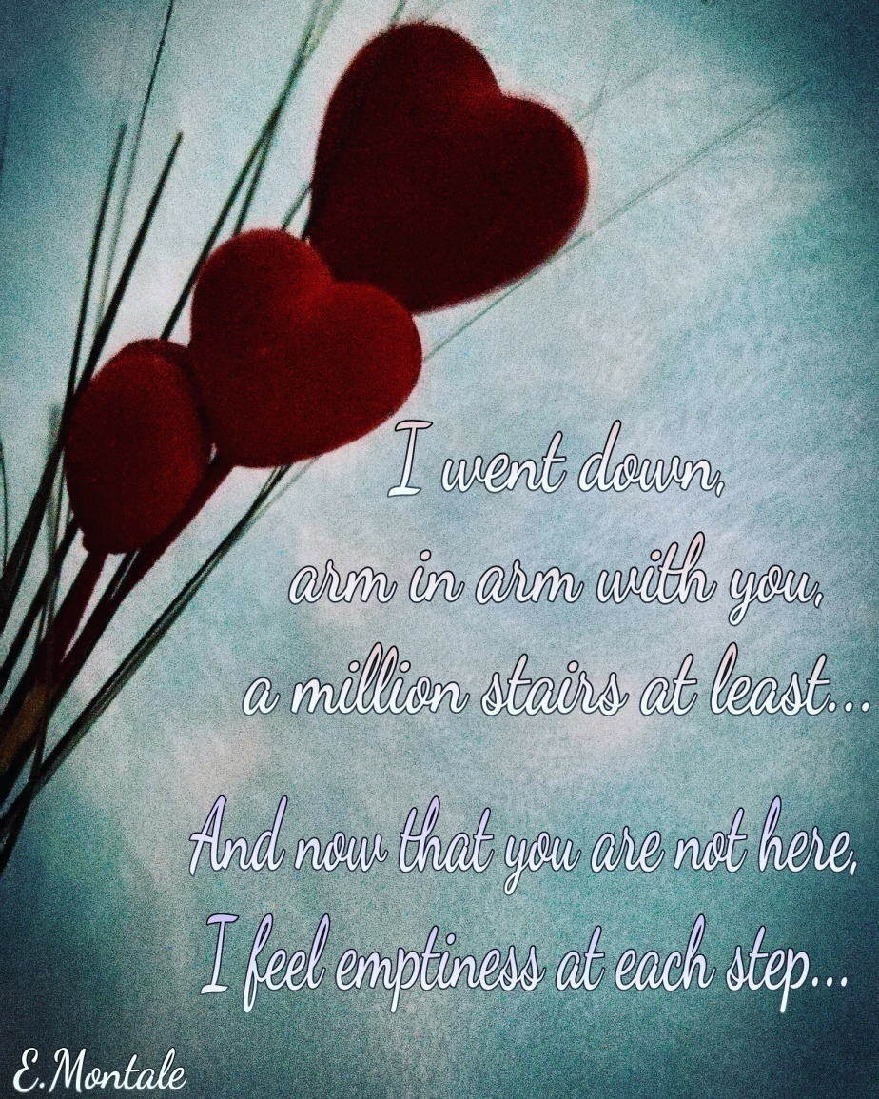
Day 21
Among the most beloved Italian poets of the 20th century, there's Eugenio Montale from Genoa. "Meriggiare pallido e assorto" is one of his most famous poems, but, among Italian female students, "Ho sceso dandoti il braccio" is definitely the favourite one. It's a moving poem that tells about the ability of Mosca, his wife, to open his eyes and to teach him to really see and comprehend the world around him. Here there is a translation by Francesca Ciambella:
❤💕
"I went down, arm in arm with you, a million stairs, at least.
And now that you are not here, I feel emptiness at each step.
Our long journey was brief, though.
Mine still lasts, but I don't need
any more connections, reservations,
traps, humiliation of those who think reality is what we are used to see.
I went down, arm in arm with you, a millions of stairs, at least
and not because with four eyes we see better that with two.
With you I went downstairs because I knew, among the two of us,
the only real eyes, although very blurred,
belonged to you.”

Slide 24
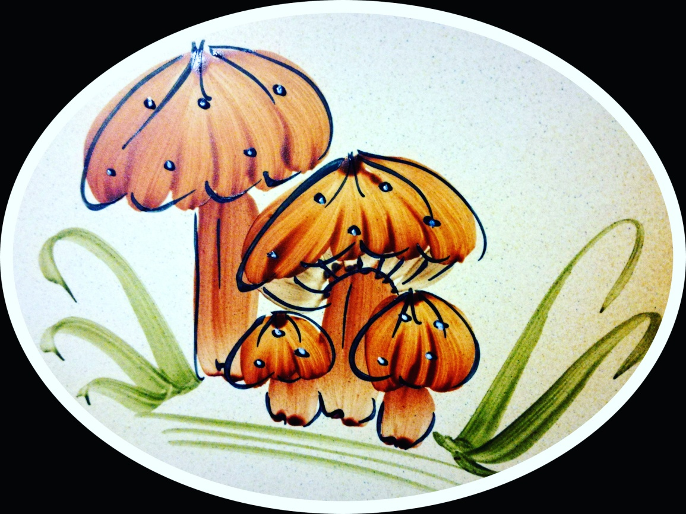
Day 22
🍄Italian mushroom pickers can be quite superstitious. Still nowadays some of them follow the old tradition of wearing the sweater or the underwear (!!) inside out for luck.

Slide 25
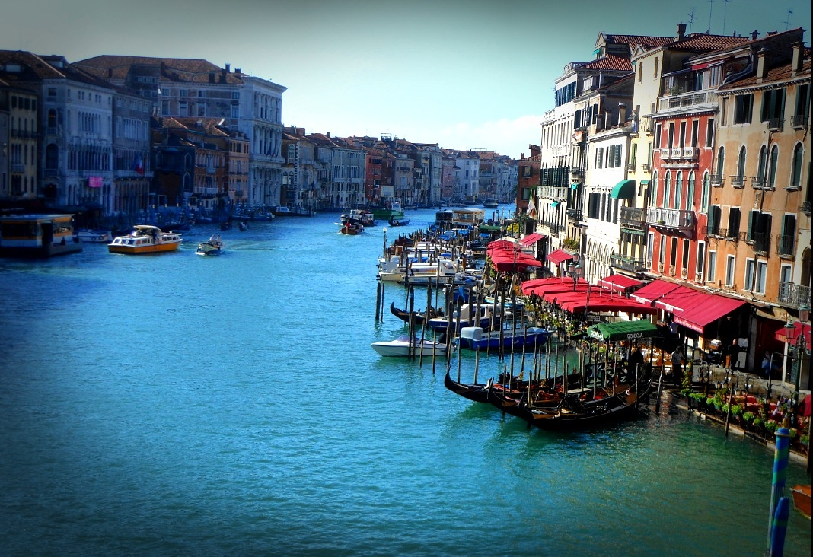
Day 23
According to a mystic belief, Canal Grande in Venice might have negative influences as its S shape reminds the shape of a snake or a dragon, the common symbols of the devil. Someone says it's not by chance that a church dedicated to St.George, who killed a dragon, was built on the little island in Canale della Giudecca, where Canal Grande ends.

Slide 26
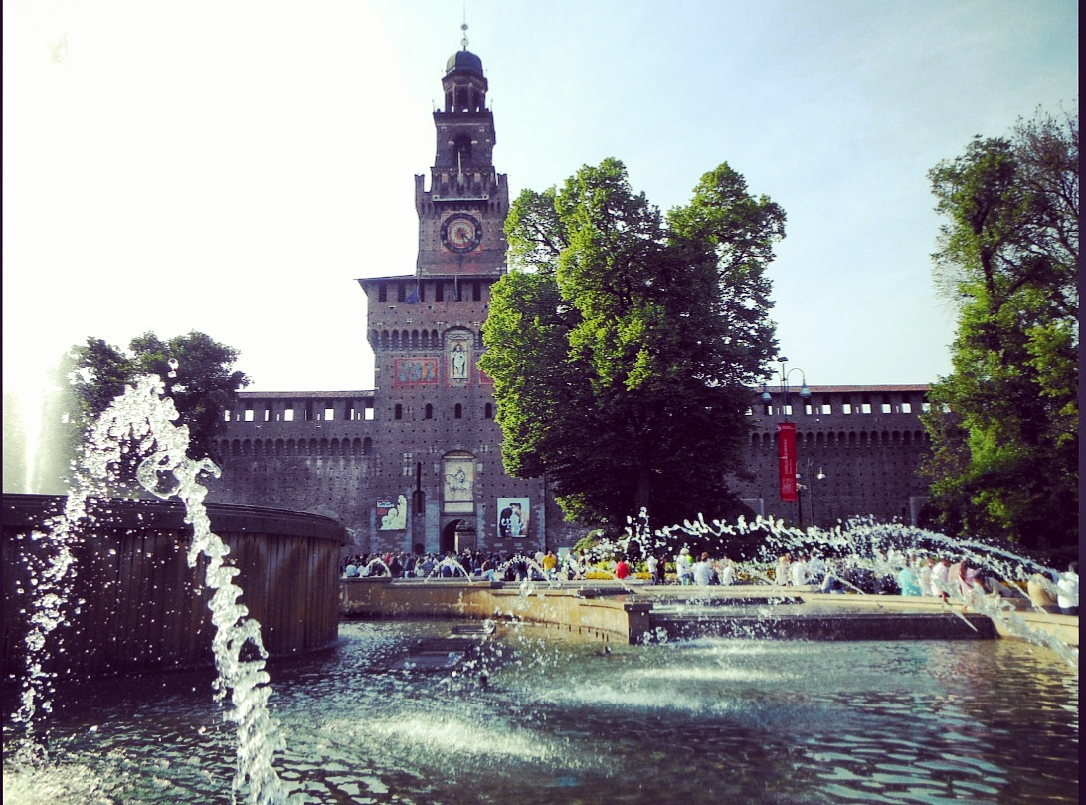
Day 24
Castello Sforzesco is presumably the most haunted place in Milan. 👻 It is believed you could encounter the ghosts of:
✔ Bona di Savoia, still lamenting the premature death of her husband;
✔ Ludovico Il Moro;
✔ Bianca Sforza, who died during her wedding night;
✔ Isabella d'Aragona;
✔ Beatrice d'Este, who died right after the delivery of a stillborn;
✔ Bianca Scappardone Visconti, decapitated;
✔ Isabella da Lampugnano, executed because she was believed a witch.
Sure you still wanna visit it?!? 👻

Slide 27
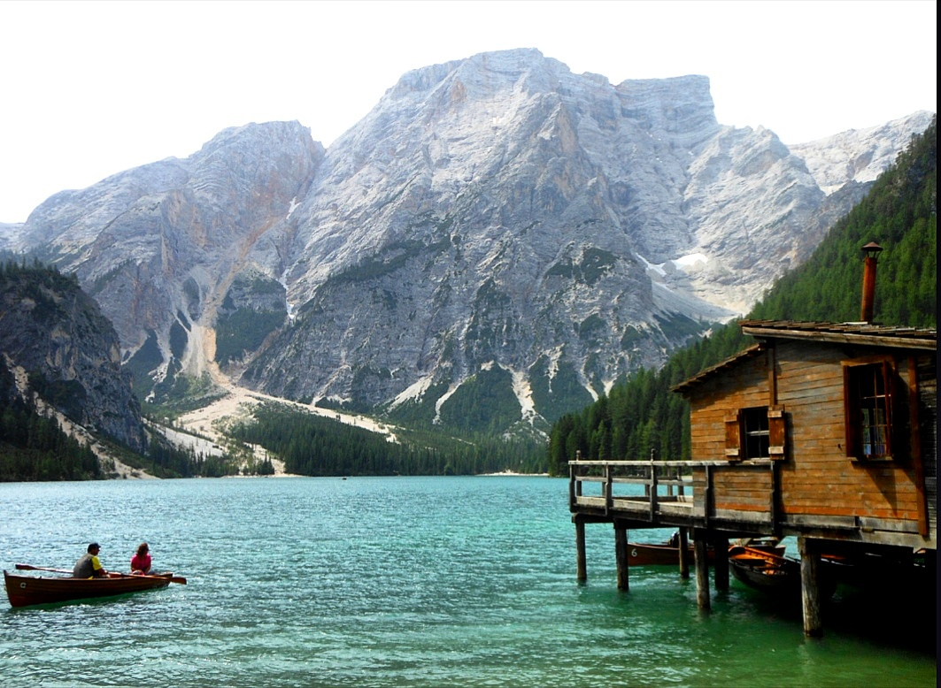
Day 25
Pragserwildsee, also known in Italian as Lago di Braies, is a stunning lake located in South Tyrol. According to the legend, it was created by savage people who inhabited that area, who wanted to protect their gold from avid shepherds. It was basically their defensive barrier against thieves.

Slide 28
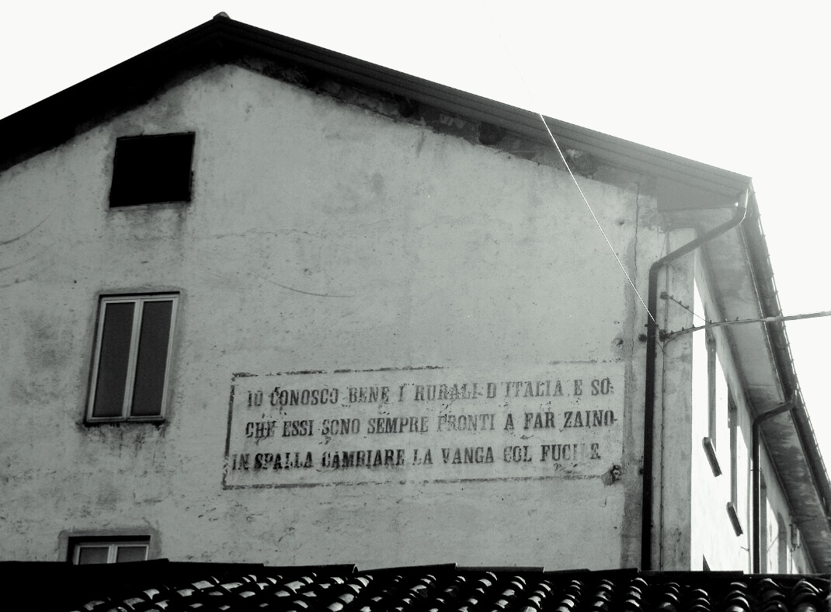
Day 26
This is an example of political propaganda during Fascist era. Extracts from Mussolini's speeches were painted on buildings like this one in Staro, province of Vicenza.
This extract states: " I know Italian rurals really well and I know they are always ready to backpack and substitute their spade with a rifle”.

Slide 29
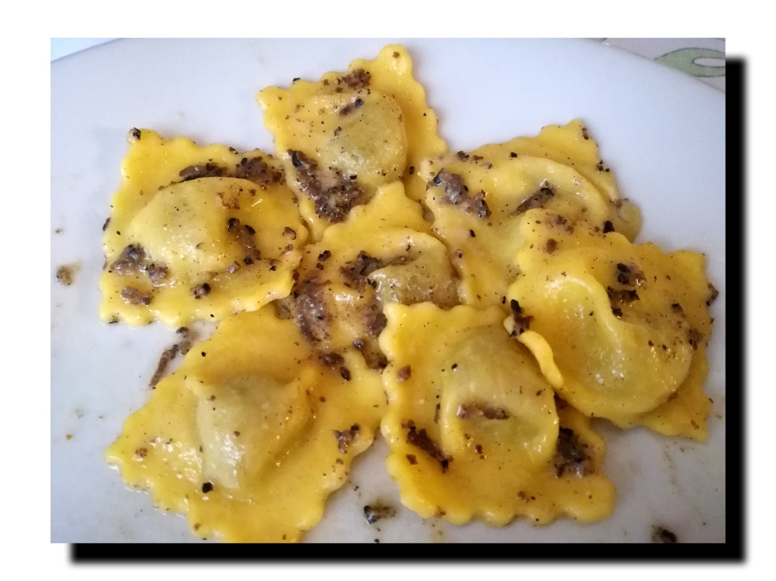
Day 27
For Italian gourmets, truffle represents a treasure, both figuratively, as it has to be dug out from the soil as some sort of pirate chest, and literally as it can be quite expensive (especially the white truffle from Alba, Piedmont).
Truffle works great with pasta and risotto.

Slide 30
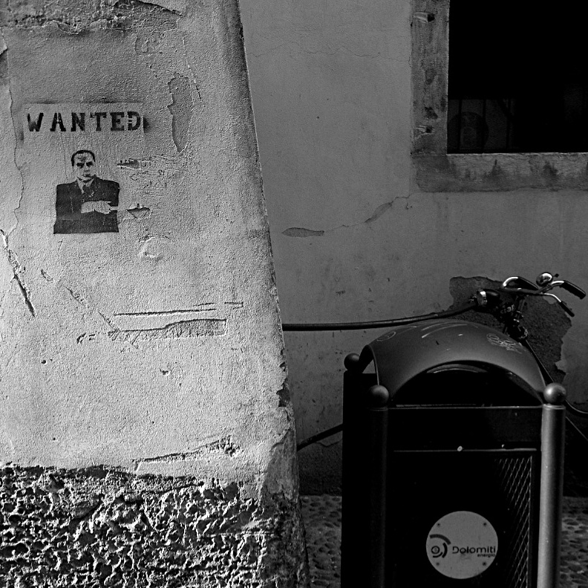
Day 28
Italian Prime Ministers are regularly nicknamed by members of the opponent parties, media and common people.
Romano Prodi, for example, was "the baloney" 🍖(yeah, the sliced meat); Giulio Andreotti, as you already know if you are a Sorrentino's fan, was "Il Divo", but he was also known as "Beelzebub" or "the Black Pope"😈 The one who detains the record of nicknames, though, is Silvio Berlusconi, who is:
✔ "the Knight" ( because he is a knight of the Order of Merit for Labour);
✔ "the psycho-dwarf";
✔ "the evil dwarf";
✔ "the bold dwarf";
✔ "papi";
✔ "Him";
✔ "burlesquoni";
✔ "the cayman";
And so on..

Slide 31
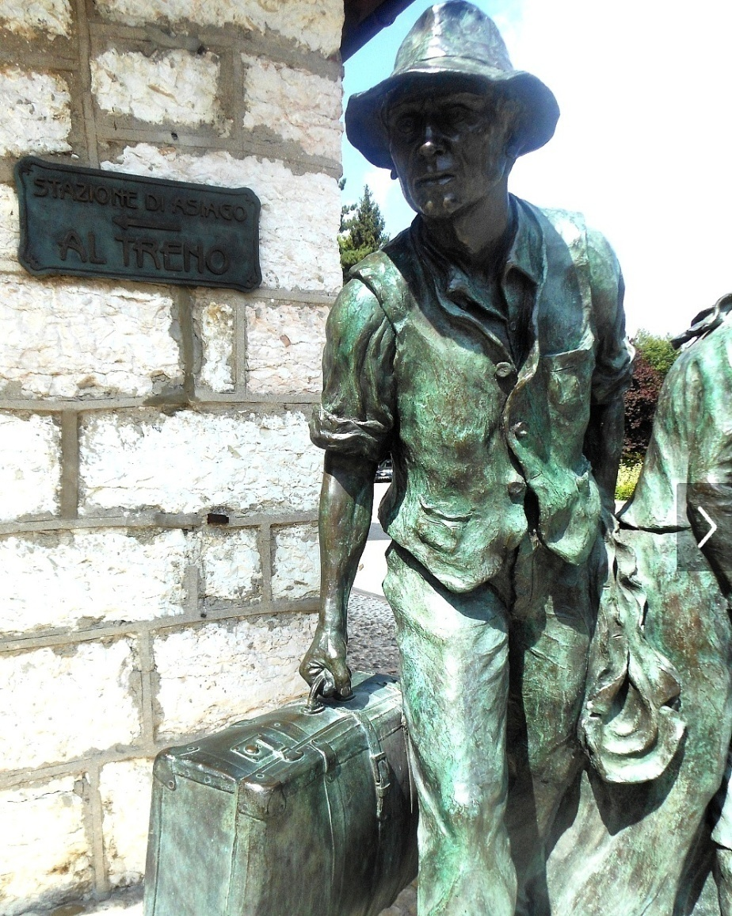
Day 29
In 2015, after decades, the number of Italian emigrants surpassed the number of immigrants who had arrived in the Belpaese🛄. Since the cost-of-living is quite high, lots of retired people choose to emigrate to countries like Portugal or Tunisia, where they can easily sustain themselves with their pensions. 👴👵 The big problem is the emigration of young people, though. Lots of sociologists have stated that "Italy is a country that hates youngsters" and journalist Beppe Severgnini, when talking about the work situation, has defined the older Italians as the "python generation", indicating with this term their will to stay attached to their seats and not give young people an opportunity. Sadly, young people are always depicted through the media as immature and "mammoni": truth is they have to deal with exploitation and underpaid and temporary employment. Most of the time leaving the motherland is the only solution.

Slide 32
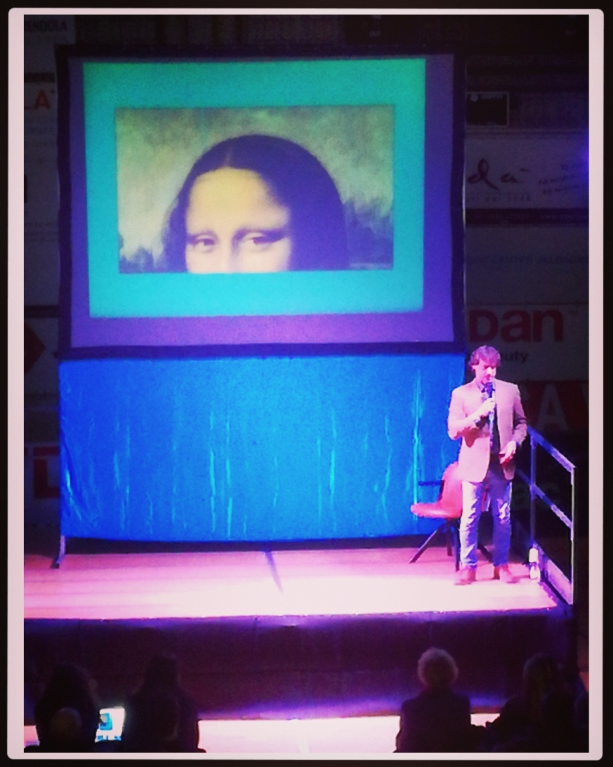
Day 30
Last night I had the chance to attend an Alberto Angela's lesson and I would like to dedicate to him and his family this entry. ❤
Alberto's father Piero was the first scientific populariser of the Italian television and his son soon followed in his footsteps . They use a simple and funny language which has been fundamental in contributing to the public understanding of science. They are literally worshipped by Italian people and Alberto's programme "Ulisse" is basically the only scientific TV programme in the world to be broadcasted on Saturday nights.
Long live the Angelas.

Slide 33
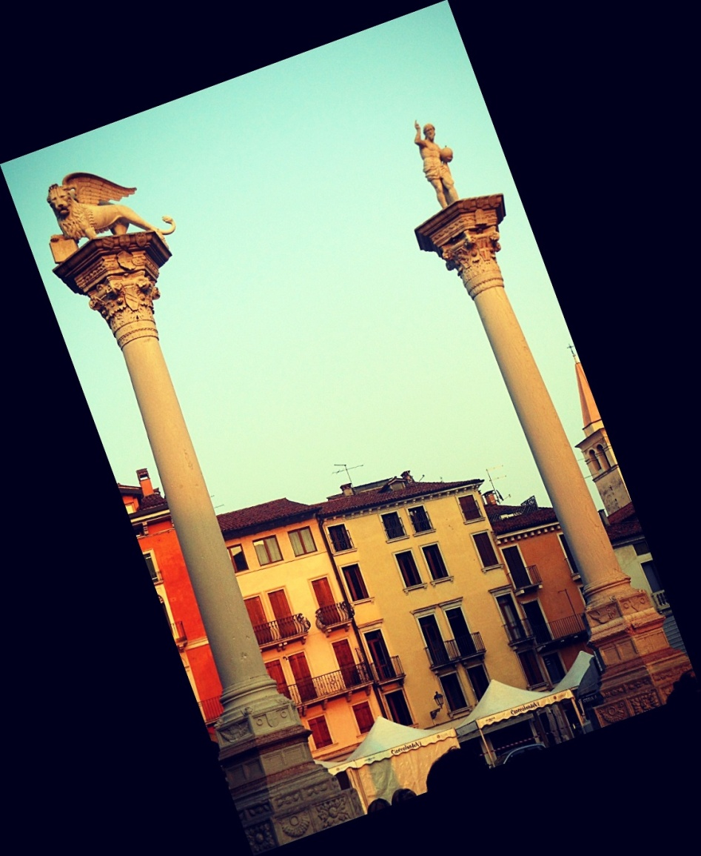
Day 31
You can find the columns of the Serenissima not only in Venice, but in all the cities that were subjected to its Republic. 🌅⛵ On top of them you can see the winged lion, symbol of Saint Mark, and a statue of the former patron saint of Venice, St. Theodor. You'll never see Venetian people walking in between the columns placed in St.Mark square, though: that was the exact spot where prisoners were hanged.

Slide 34
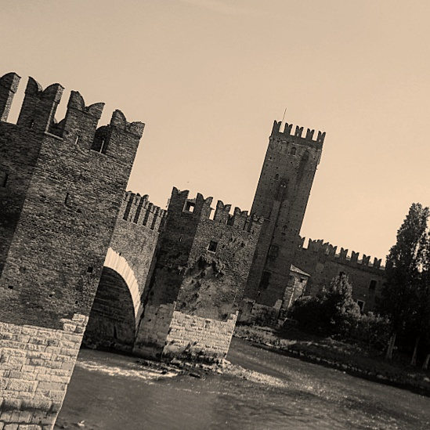
Day 32
History books often indicate Italian Middle age as a very dark period. Truth is that, as all the periods of crises, it brought also some interesting results, like inventions. Some examples of Italian Medieval inventions?
✔ glasses
✔ musical notation 🎵🎶
✔ice cream 🍦(well, its ancestor)

Slide 35
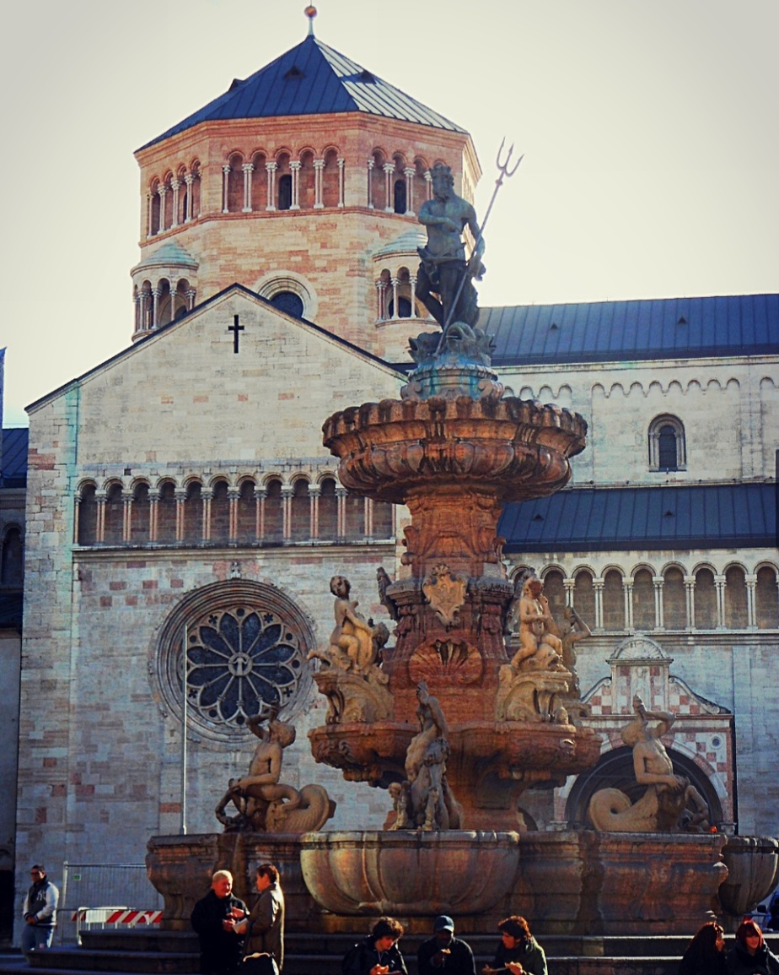
Day 33
In Italy there are at least 12 fountains of Neptune, two of which are in Piazza del Popolo and Piazza Navona in Rome. The one you can see here is in Piazza Duomo in Trento, Northern Italy.

Slide 36
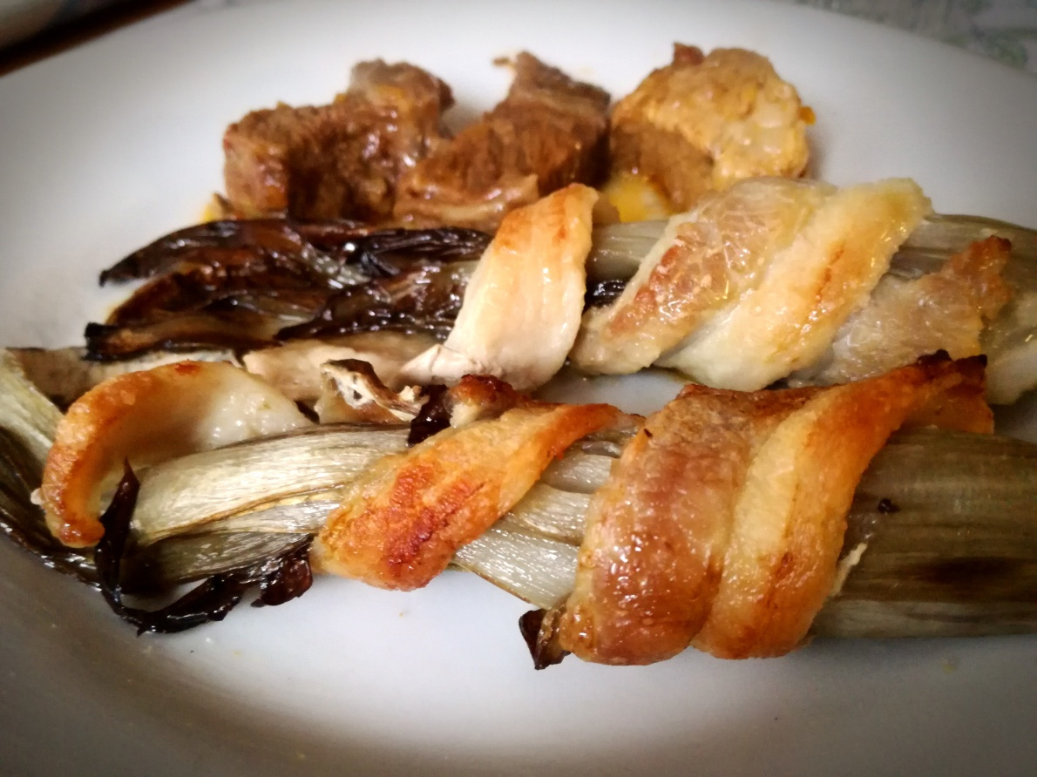
Day 34
As you know, Italians take food very seriously and this year we celebrate the 20th anniversary of the PGI certification of the Red Trevisano Radicchio! The Protected Geographical Indication granted by the EU is very important stuff for us!👍 In this pic you can see Trevisano Radicchio with pancetta.

Slide 37
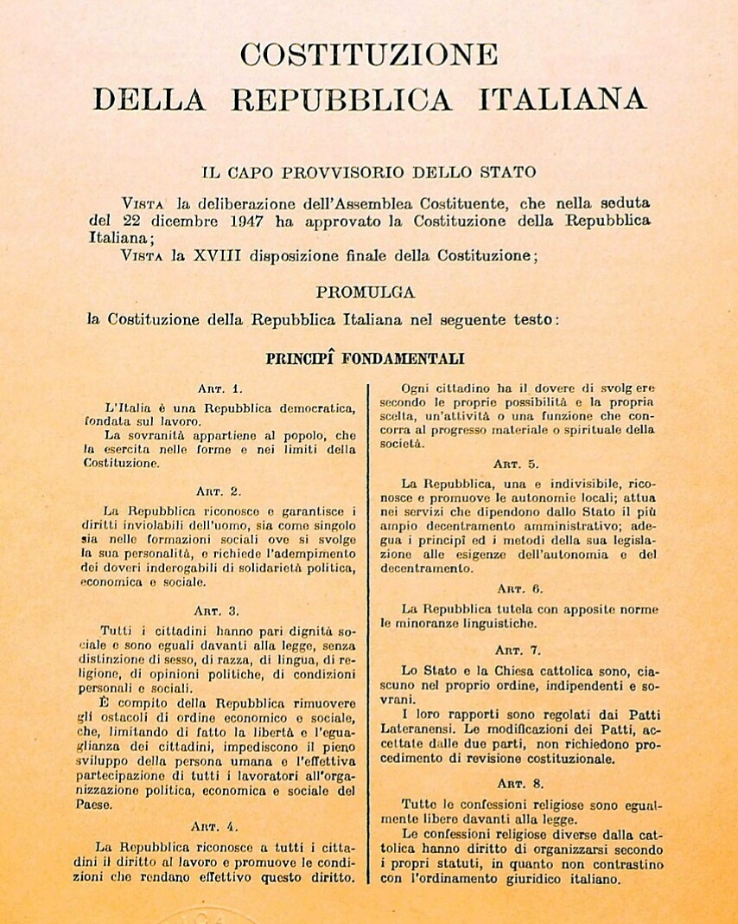
Day 35
The Italian Constitution came into force in 1948, few years after the end of WWII. The Parliament is a bicameral entity, which form is "perfect": this means both cameras have the same powers and they have to approve and control the work of the other one. This is a form which was studied as to guarantee democracy and avoid the ascension of new dictatorships. As one of Constitution's fathers liked to point out "Constitution was created into the mountains where Partisans had fell during the war".

Slide 38
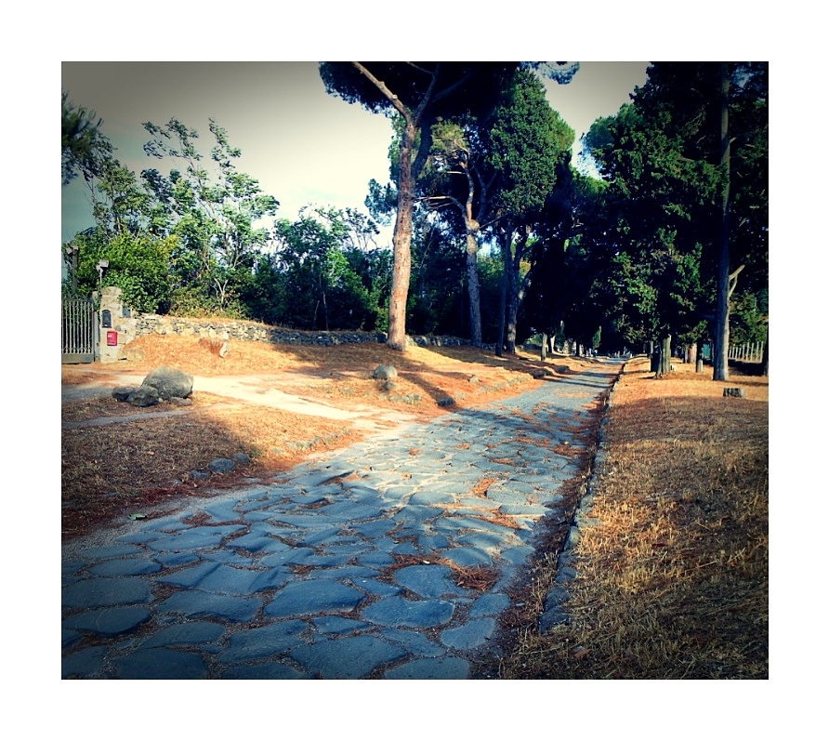
Day 36
As Pliny the Elder stated: "Romans put their effort in three things, which had been previously neglected by Greeks: roads, aqueducts and sewage systems". These three things were surely an important step toward healthiness and modernity. Thanks Romans! In the picture you can see a tract of the old Appian Way, "the queen of the long roads", in Rome.

Slide 39
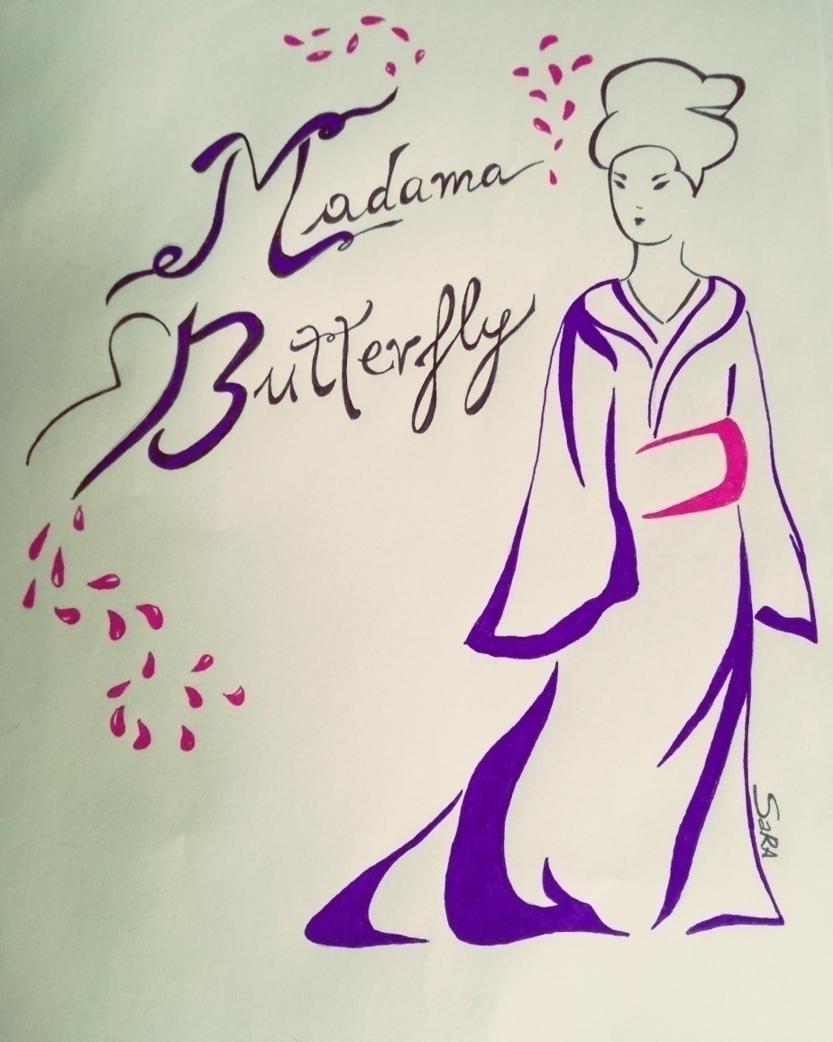
Day 37
For the Catholic calendar, Dec. 7th is St.Ambrose, the patron saint of Milan. Every year, on this day, there is the seasonal premiere of La Scala theatre, which is a huge event. This year the opera will be Madama Butterfly by Puccini. For the first time we will be able to see the premiere on Raiuno, the national TV channel. I'm not an artist (can you tell??), but here you are my take on Madama Butterfly.

Slide 40
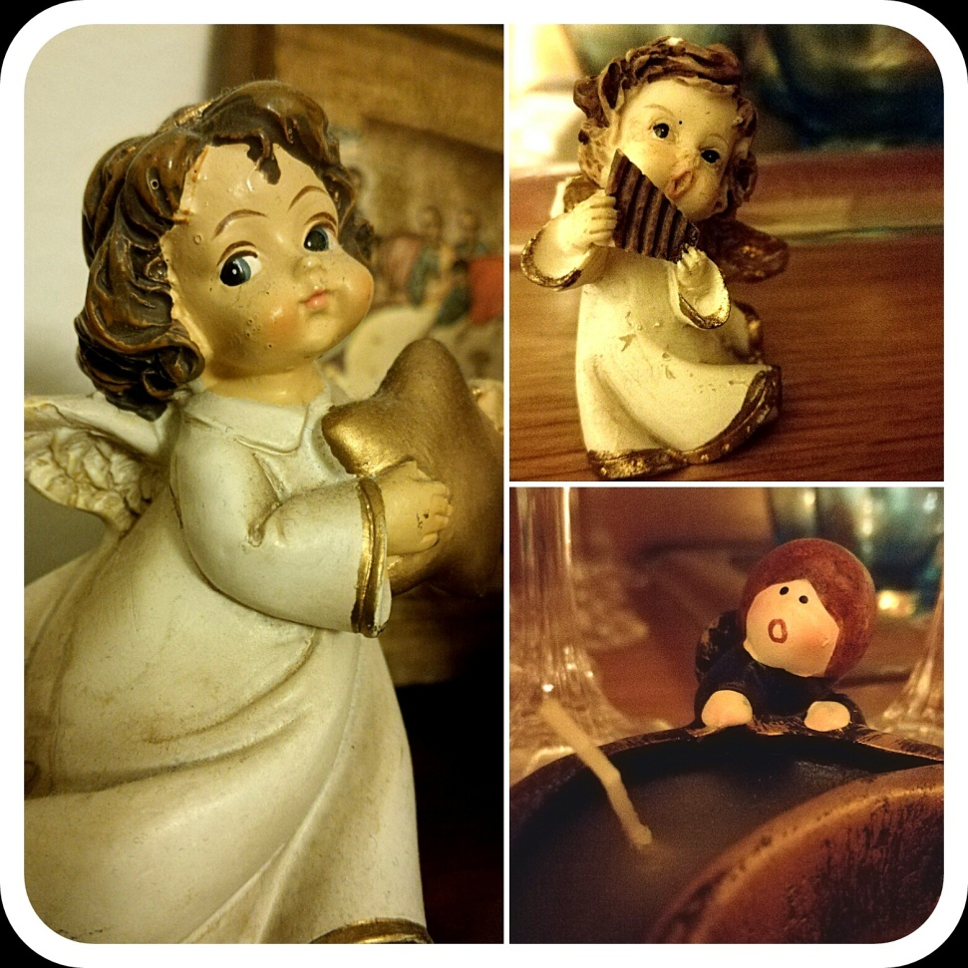
Day 38
Dec. 8th is a religious holiday in Italy as it is officially “Immacolata Concezione”, the day in which we celebrate the Virgin Mary, mother of Jesus. Many Italian families take advantage of this free day to start decorating the house and setting up the Christmas tree and presepe, the reproduction of the Nativity.

Slide 41
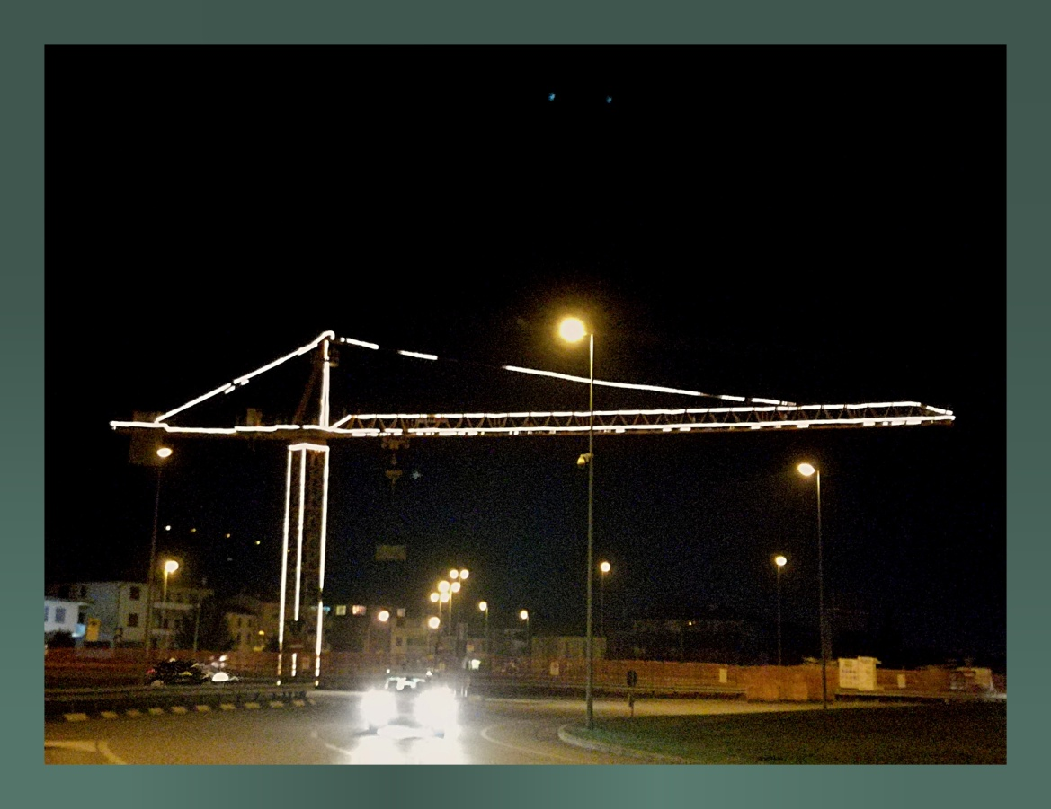
Day 39
People from my corner of Italy, which is Veneto, are often indicated as too much interested in money and always focused on work. I don't know where they got this idea, look how sentimental we are, putting Christmas lights on our cranes!

Slide 42
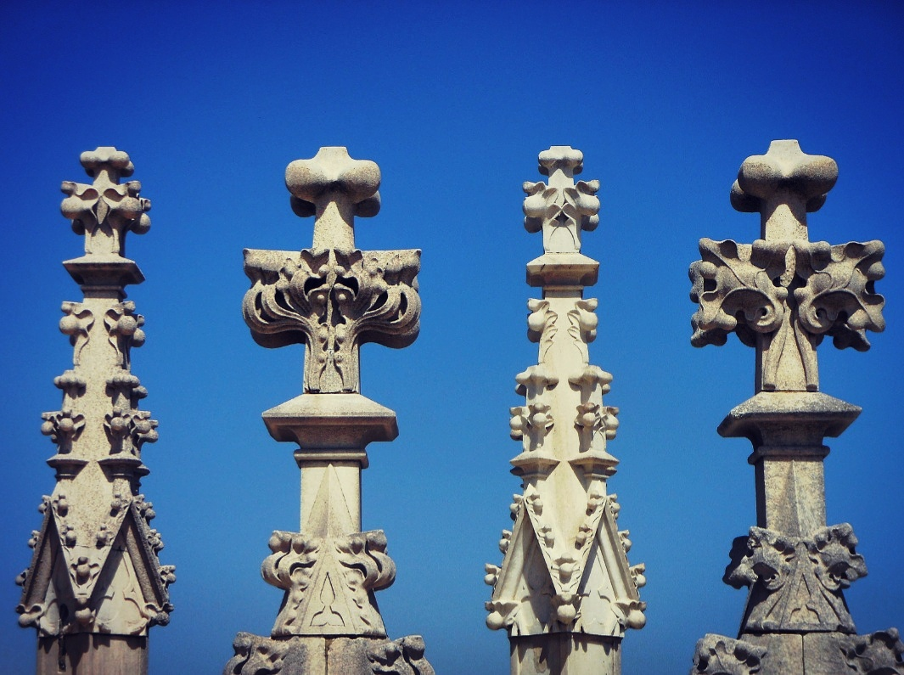
Day 40
One of the best things to do in Milan is visiting the roof of the Cathedral and have a close-up of its amazing pinnacles and sculptures that would be otherwise unappreciated. Also the view of the city is amazing. ⛪❤
This summer a 23 yo guy from the USA, remained trapped for an entire night on the roof: according to his version, he was in the toilet when they closed the cathedral (!!) Others think that, being him an art lover, he might have decided it was a good idea to hide and enjoy all that art on his own! Who knows!?! [In the pic a detail of the roof❤]

Slide 43
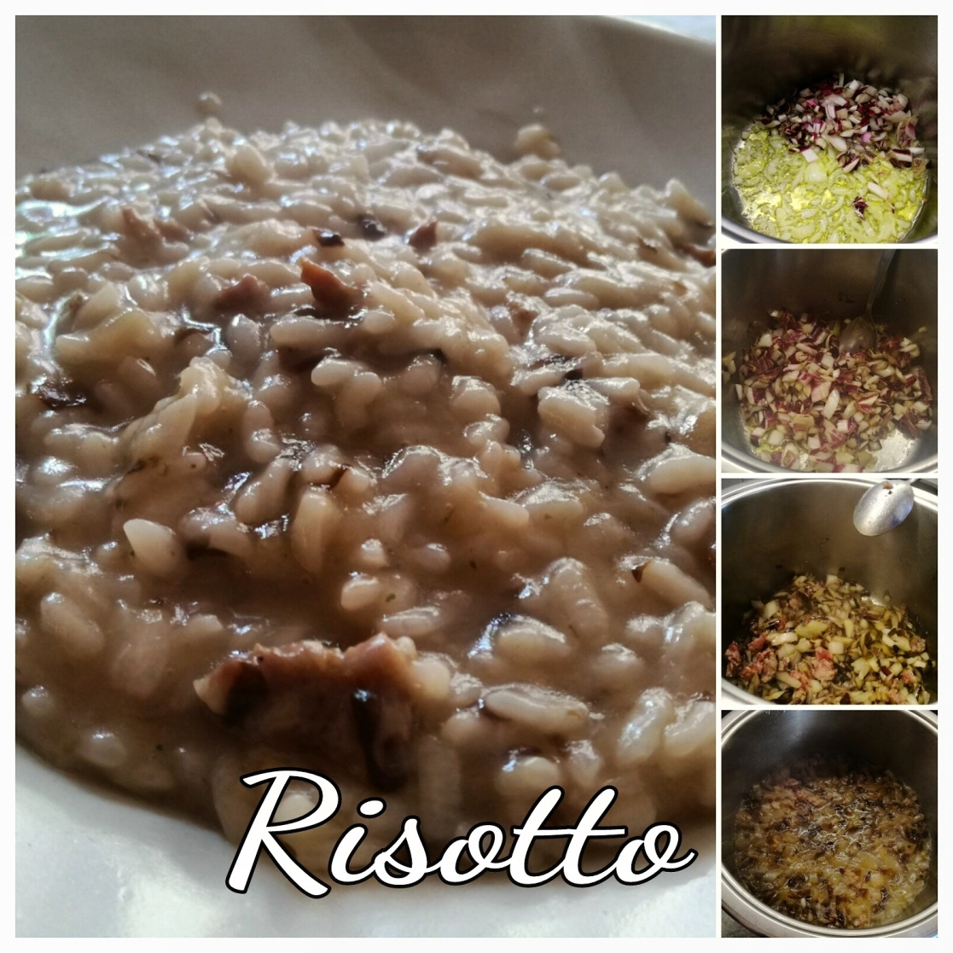
Day 41
Risotto is a first course of the Italian cuisine, mainly consumed in the Northern part of the peninsula. It's a rice dish cooked in a broth to a creamy consistency. 🍚🍴
On the right you can see the preparation of the broth: we prepared a soffritto of onion, olive oil, radicchio and meat. Then stock must be added. Someone puts water instead of stock, but the purists do not agree on this. There's a say in Italy that states that since rice grows in the water, it must not be "killed" in it.

Slide 44
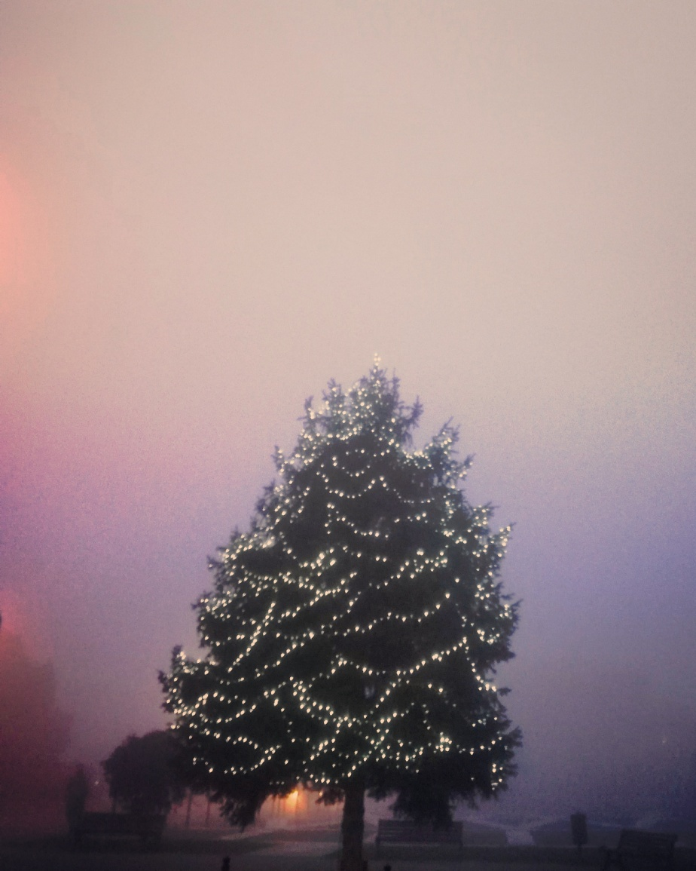
Day 42
Fog and humidity are faithful companions of the inhabitants of the so-called Po Valley in North-Eastern Italy. They're such a constant that there's even a song dedicated to them called "Fog in Po Valley" 🎸🎤 They're surely not good for your bones and when driving, but they are great for mystery tours and ghost stories .

Slide 45
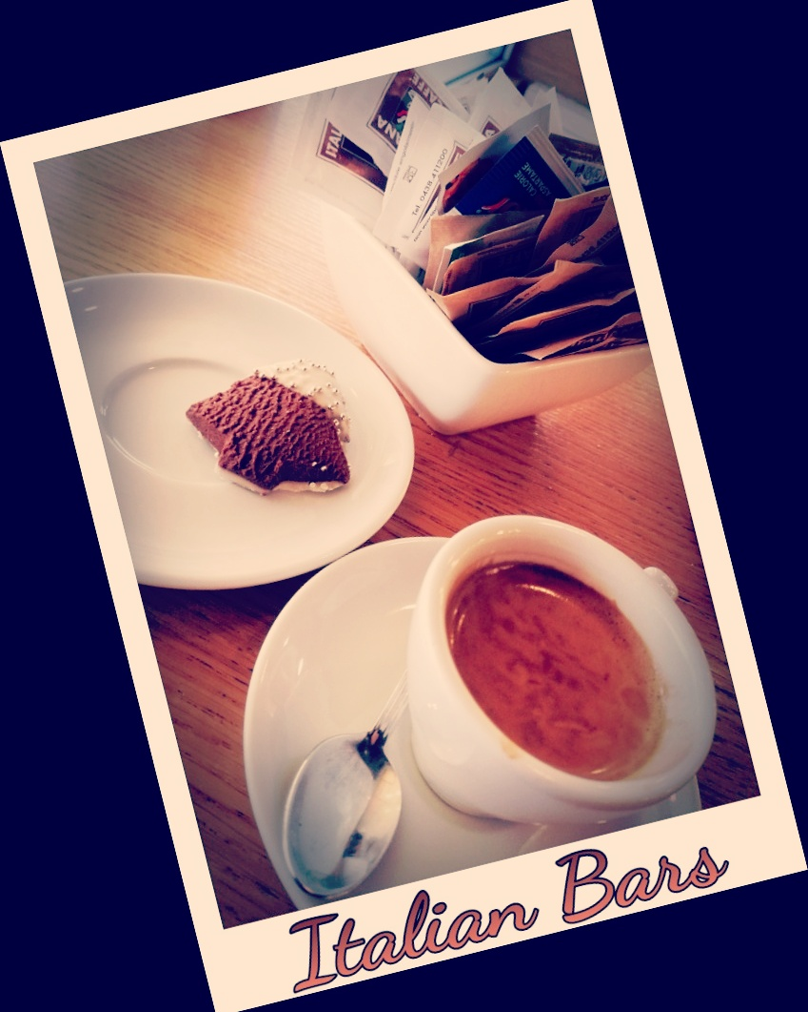
Day 43
I think it's time to clarify some things concerning Italian cafès (or bar, as they are always called in Italian) and to debulk some myths I've being seeing spreading around in numerous travel blogs. ✔☕ "When drinking a coffee, don't sit at a table or you'll spend more" ▶ well, it depends. Surely bars located in famous touristic spots take advantage of the high flux of people to put different rates, but in all the other places you usually pay the same price for a drink, being you at a table or not. If you're not sure if the bar you're in has different rates, just ask the barista or check the price list before sitting. By law, they HAVE TO specify the prices. If they omit them or they try to scam you, protest. Forcefully. ✔☕ "Don't order cappuccino after 11am 🕚" ▶ when I read about this "rule", I imagined tourists checking their clocks to make sure they were on the right time frame to drink a cappuccino XD Let's make things clear. It's true, Italians USUALLY have cappuccino only for breakfast. But if we are out with friends and we want to drink it at 4pm, we just order it. 🌟You're the customer, you can have what you want!🌟 The only things I can recommend to you is to avoid drinking it just after lunch or dinner. Milk is not easy to digest, especially after a rich Italian meal :/ 💡Bonus aspects to consider:
✔ you can sit at a table without having to keep ordering stuff to "maintain" your place. Bars are places where people go to chat and stay together, so you can just order a coffee and have a long satisfying chat without seeing baristas glaring at you.
✔ tips are not required.
✔ Espresso is the best thing in the world. FIGHT ME.

Slide 46
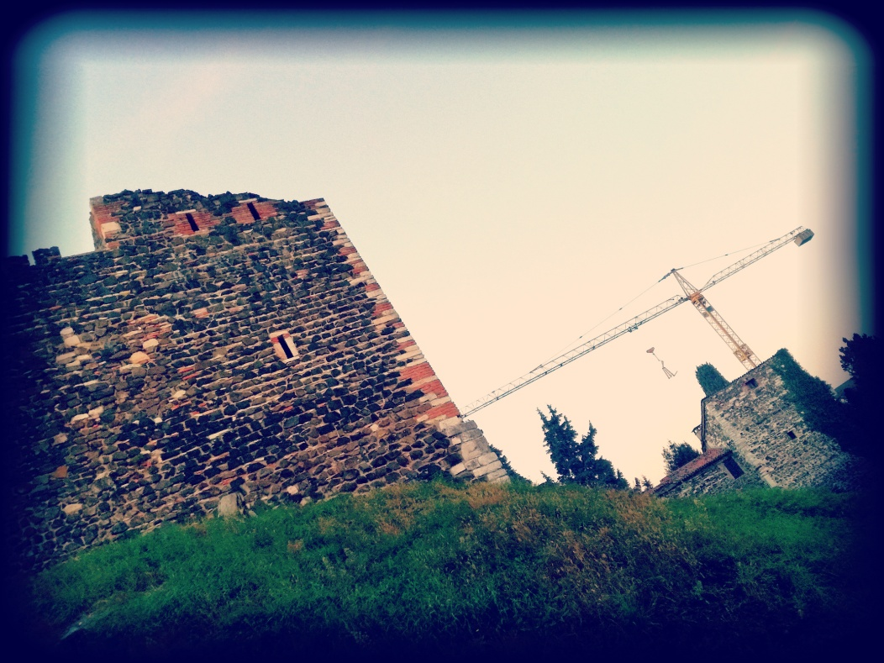
Day 44
The balance between past and future is a tricky topic in Italy.
Where lies the boundary between preserving the heritage and working for progress? The answer is not always obvious and the truth, as always, is in between: the coexistence and the profitable exchange between the two is what we all must work for.
⏳"Learn from the past, prepare for the future, live in the present"⏳

Slide 47
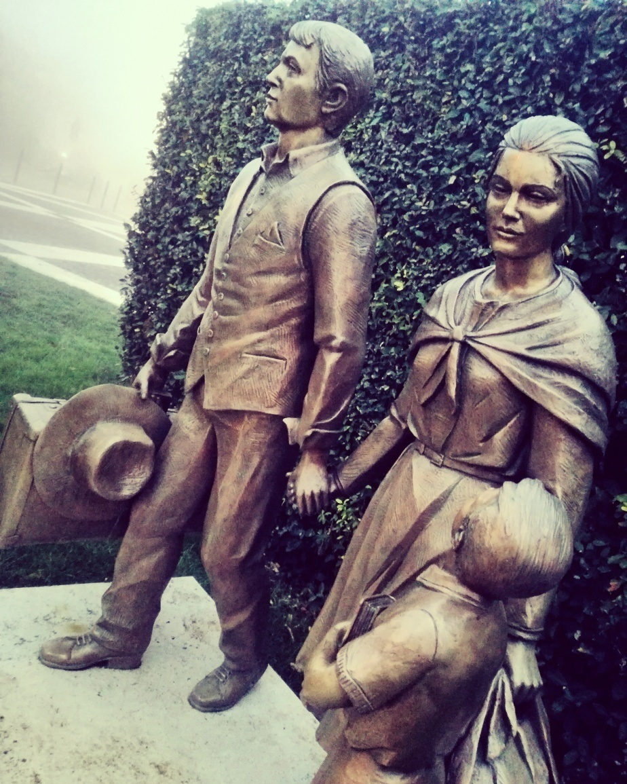
Day 45
Family is the core of the Italian Society. Still nowadays it is the most valued social environment, as it provides protection, nourishment and love. 👪❤Apart from specific and rare instances, you can always count on your family if you need help.
It's not by chance if the kid in this sculpture looks up to his mother: the woman still plays the major role in a family and, metaphorically speaking, it is said that, in a home, "she sustains three walls out of four".

Slide 48
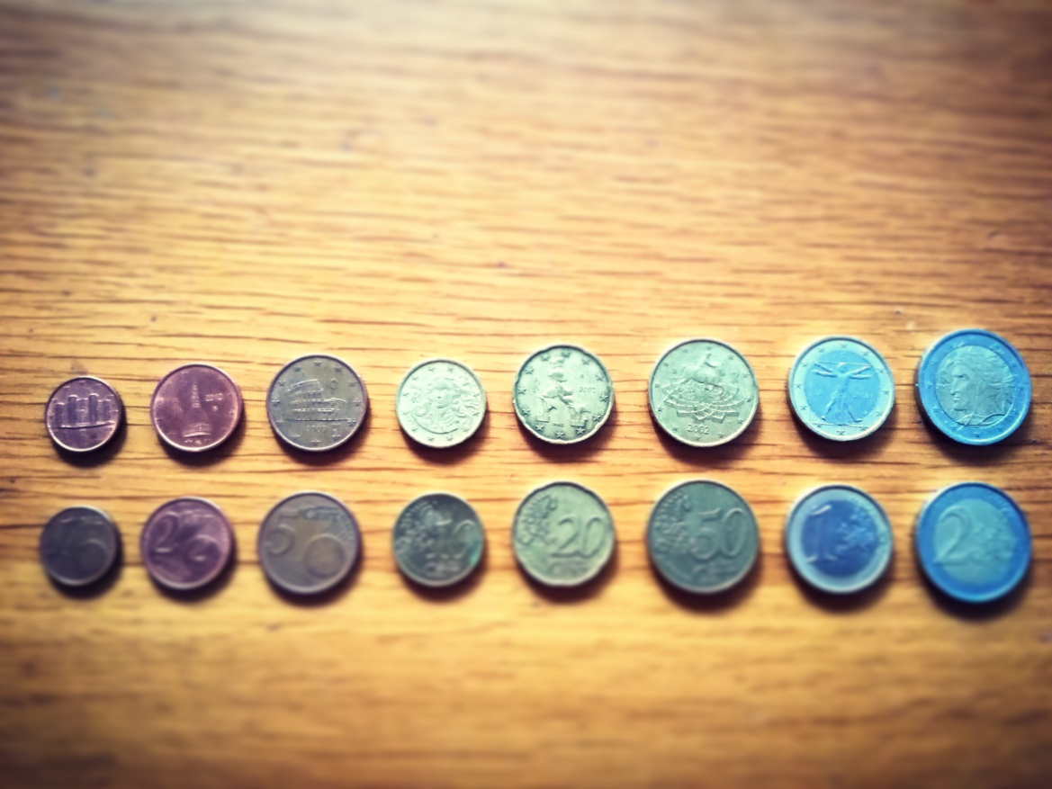
Day 46
Euro coins have different designs according to the country in which they are adopted. Italian euro coins are truly unique in their genre, as their designs were chosen directly for you by...Italians!
On 8th February 1998 we voted by phone in order to choose the designs to mint in each coin (the only exception was 1€ coin, which design was already picked by our then economy minister). It was a cool campaign as it involved Italians in this new EU adventure and promote our heritage abroad (free publicity as coins circulate in all EU countries 💸).
✅ The chosen designs:
✔ 1 cent – Castel Del Monte in Andria, Apulia;
✔ 2 cents – Mole Antonelliana in Turin;
✔ 5 cents – Colosseum in Rome;
✔ 10 cents - The Venus of Botticelli;
✔ 20 cents - "Unique Forms of Continuity in Space", a futurist sculpture by U.Boccioni;
✔ 50 cents – Marcus Aurelius' statue in Campidoglio;
✔ 1 € - The Vitruvian Man by Leonardo da Vinci;
✔ 2 € - Dante Alighieri, portrait by Raphael.
We might always be on the verge of an economical crises, but hey, at least our coins look good, haha.

Slide 49
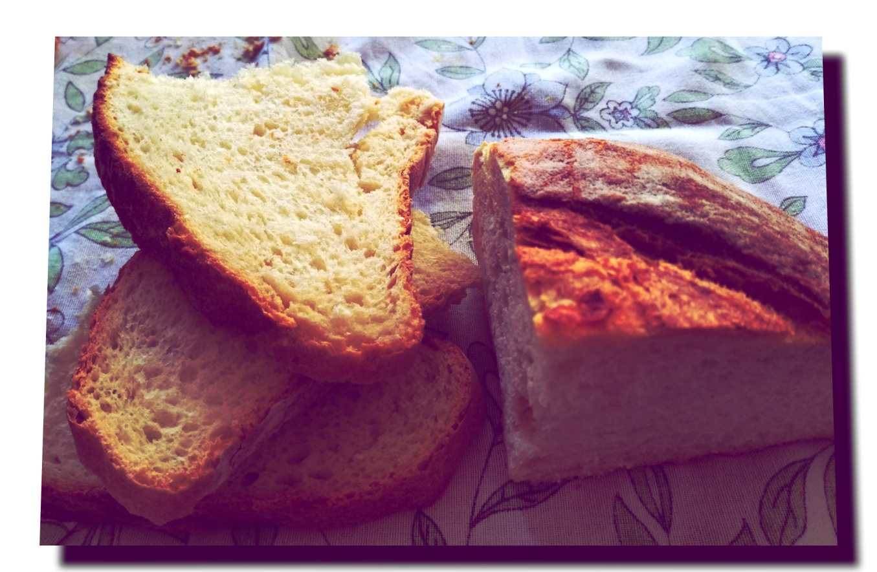
Day 47
In Italy there is always an embarassing wealth of options in terms of bread: according to the area you're in, you find different varieties. It is common knowledge, though, that the best Italian bread is to be found in Altamura, Apulia. Latin poet Horace, talking about this city, said:"their bread is exceeding fine, inasmuch that the weary traveler is used to carry it willingly on his shoulder". In 2003 "bread of Altamura" was granted PDO status within Europe.

Slide 50
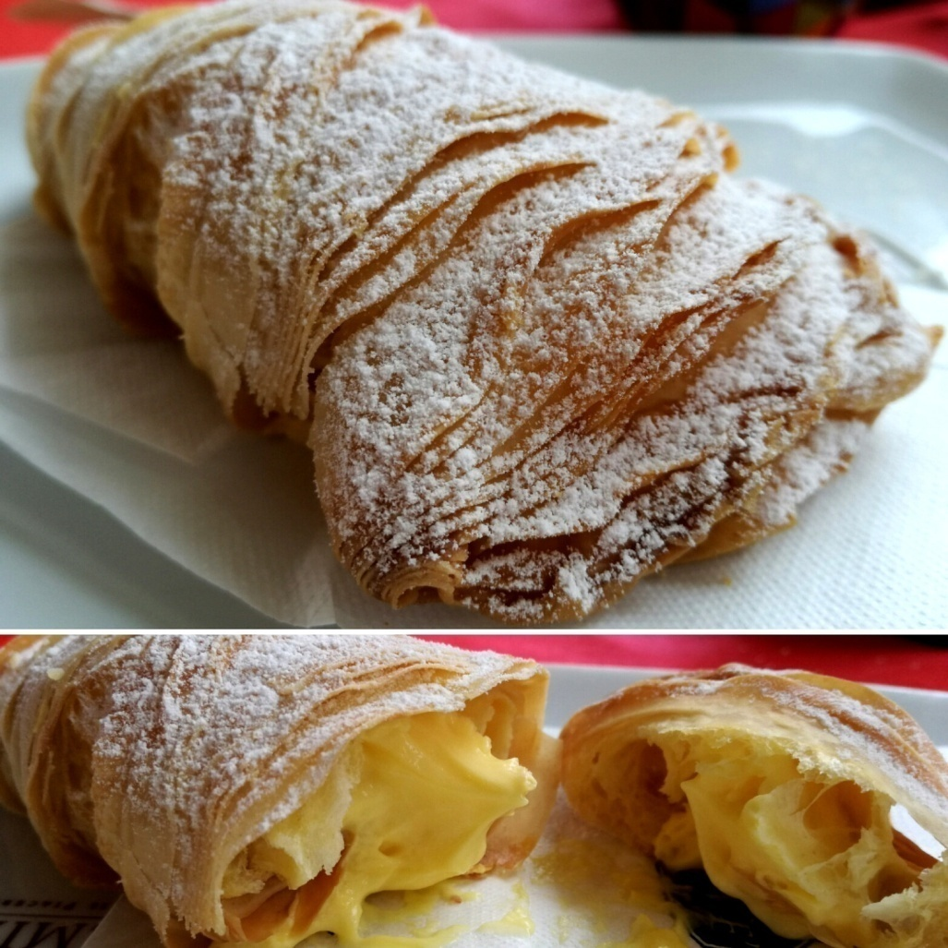
Day 48
Sfogliatella is undoubtedly the best gift Naples made to this world. It’s a heavenly creation which name means “thin leaf/layer” and that was originally created by a nun in a convent. There are two kinds of this pastry: “sfogliatella riccia” (curly) and “sfogliatella frolla”. The one you can see in this photo is a variation of sfogliatella riccia called “lobster tail” which is filled with french cream. When in Naples, try it and then thank me forever.

Slide 51
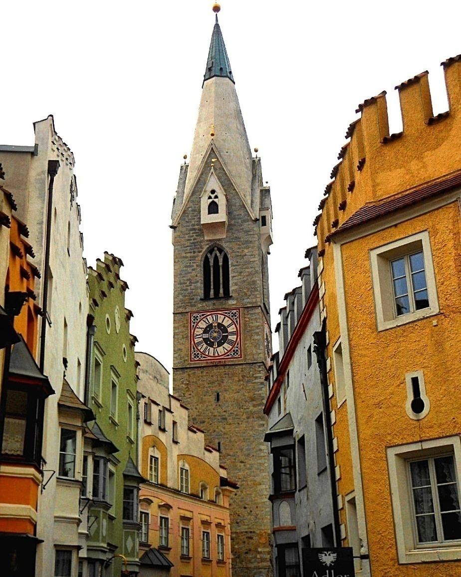
Day 49
The Autonomous Province of South Tyrol is a peculiar area in Northern Italy. It's populated by people who belong to three different ethnic groups: the German, the Italian and the Ladin ones. Cities and place names must be indicated both in German and Italian language and the region is granted with a high level of self-government. They can retain a very large part of their taxes and they even have legislative powers concerning health, education, work and transport system.
❇ In this pic there's a view of Brixen / Bressanone, the third largest city of South Tyrol.

Slide 52

Day 50
Today I wanted to celebrate the completion of the first half of my challenge by providing you with the most famous incipit of Italian Literature: the beginning of Divina Commedia by Dante. I chose it, because Dante wrote that he was midway upon his journey and so I thought it was appropriate for this occasion (he referred to the "journey of life", though!) Divina Commedia (Divine Comedy) is considered the most important work of Italian Literature. 📖 It represents the poet's vision of the afterlife and it is divided in three parts: hell, purgatory and heaven.

Slide 53

Day 51
Presepe is the reproduction of the scene of Jesus' nativity which happened in peculiar circumstances (according to the tradition, while on voyage, Jesus' parents were refused a room from various "hotels" and they had to find shelter in a cave when her mother was about to give birth). 👪
Presepe can have various forms:
❇ there's the so-called "presepe vivente", where real people re-enact the scene;
❇they use human-size statues to set up a big presepe in piazzas;
❇ in normal homes, families build a presepe of small dimensions with little statuettes. When setting up a presepe you leave baby Jesus'place vacant until the 25th Dec. [In the pic a baby Jesus].

Slide 54

Day 52
Among the most hilarious souvenirs that you can find in Italy -apart from silly magnets with a breast of Juliet (Verona) and with the nether regions of the David (Florence) - there is the infamous can that contains "air of Naples".
Apparently it all started like a joke: after WWII Gennaro Ciaravolo, a man from Naples, started to claim that he had sold cans of "air of Naples" to American soldiers. The legend soon spread around and, even if that was not true, nowadays you can find those cans in shops around Naples for real!!
[In the pic, an innocent trullo from Alberobello, coz you know, I've never felt like buying cans of air ].

Slide 55

Day 53
The typical Italian breakfast consists of cornetto and cappuccino (or espresso )☕🍩. As a general rule it is always a simple "sweet breakfast" made of caffeine and a dose of glucose. According to a lot of experts, it is actually not a bad idea to ingest sugary stuff in the morning, as you have all the day to assimilate it. Better in the morning than in other parts of the day.

Slide 56

Day 54
Christmas in Italy is little about gifts and much more about (guess what) food. The traditions change according to the specific Italian area we are talking about. Lots of people celebrate Christmas Eve with a fantastic dinner, whereas others are more focused on the lunch of the 25th (like in my corner of Italy). In Naples, for example, people like to celebrate Christmas Eve with a rich dinner with fish specialities.

Slide 57

Day 55
According to the word-of-mouth, presepe was officially invented by St.Francis, the patron saint of Italy, who introduced for the first time a "presepe vivente" (a living presepe, with real people re-enacting the Nativity).

Slide 58

Day 56
The first who discovered that the rings inside the trunk correspond with the years of the tree was Leonardo da Vinci. 🌳🌲

Slide 59

Day 57
Dolomites and Small Dolomites are mountain chains in Northern Italy formed by dolomitic rock.
Some interesting facts about Dolomites:
✔ Because of the characteristics of the rocks, they are also known as "Pale Mountains";
✔ They were the frontline between the Italian and Austro-Hungarian armies during WW1;
✔ In 2009 Dolomites were declared UNESCO World Heritage Site;
✔ Sunrise and sunset are the most beautiful time frames for these mountains, as they reflect the light and they become red.

Slide 60

Day 58
In Italian detective novels are indicated with the name of "romanzi gialli" (yellow novels), as a famous publishing house used to print this kind of books with yellow covers.

Slide 61

Day 59
Jeans are often believed an American invention, but, even though they were patented in the USA, they actually come from Genoa, Italy. They were often used by Genoese sailors.

Slide 62

Day 60
In Italy the butterfly is a symbol of fickleness: for this reason a man who is fickle in love is indicated as "farfallone", which means "big butterfly“.

Slide 63

Day 61
Italians are almost required to eat certain food for the dinner of New Year's Eve as it is considered propitiatory for the following year. In particular:
✔ grapes 🍇;
✔ cotechino🐖;
✔ lentils.
Grapes and lentils are supposed to bring money 💰💲

Slide 64

Day 62
Rivers in Italy are short, as mountains and seas are generally nearby and, as a consequence, also the head and the mouth of the rivers.
The longest river in Italy is Po, which is 652 km (405 mi).

Slide 65

Day 63
According to the data of Caritas, in Italy the people who live below the poverty line are mainly those who are under 35 (10,2%).

Slide 66

Day 64
There is some controversy about this topic, but according to several people, Fascist architecture was the last architectural "movement" in Italy. 🏢 During the Fascist era, the style was quite austere with elements that reminded the classical era, like the eagle and the Roman fasces (see the picture on the left) and few decorative elements like low relief and statues (on the right an allegory of the "vapour" outside the train station of Bolzano). You can see Fascist architecture mainly in post offices, stations and courthouses.

Slide 67

Day 65
Italy is the major European producer of shoes 👠👢 Shoes that are made in Italy are generally known for their high quality and great design. This kind of industry is mainly located in Le Marche region, Central Italy.

Slide 68

Day 66
Sampietrini (literally "small St.Peters"?) form a kind of pavement that you find in historical city centers in Italy. They are called like this because in the 16th century Pope Pius V wanted them to be used in St.Peter's square in the Vatican city. In the following centuries they were used to pave all the main streets of Rome.
Even though they are strong and they adapt easily to the irregularities of the ground, nowadays they are considered dangerous and slippery, and so they are only used in pedestrianised areas. They are hell for women who wear stilettos, though.

Slide 69

Day 67
In Italy on Jan.6th we celebrate the Epiphany. We add the statuettes of the three kings in our presepe and kids go check the socks they put in front of the fireplace the night of the Epiphany Eve. The night between the 5th and the 6th, an old woman called befana is supposed to fill kids'socks with:
✔ candies if they are well-behaved;🍬🍭
✔ coal if they behaved badly.😈 The figure of the befana is a little bit controversial: kids obviously love her as she brings candies, grown-ups sort of despise her as she is the one who takes all the festivities away (epiphany is the last festive day after Christmas). For this reason in several Italian piazzas, a puppet representing the befana is burned at a stake.

Slide 70

Day 68
With the Epiphany day it officially starts the period of Carnevale which lasts until the so-called Fat Tuesday, the day that precede the penitential season of Lent for Christians.
Carnevale typically requires people to wear masks and costumes, as to hide their true identity and pretend to be someone else. The most common masks are those belonging to commedia dell’arte, like Arlecchino (Harlequin), the servant with the chequered and colourful costume.

Slide 71

Day 69
One of the most famous festivals related to Carnival is the so-called "Battle of Oranges" that takes place in Ivrea, Piedmont. 🍊
It is the largest foodfight in Italy and it sort of represents a medieval battle with the oranges that replace old weapons.
The battle consists of people on foot throwing oranges against people riding in carts.
As you can imagine this battle is often contested for its violence.

Slide 72

Day 70
Despite the difficult situation we are going through, Italy is still the 3rd largest national economy in the eurozone and the 8th in the world. 💱💹
Concerning the secondary sector, the backbone of the Italian industry is represented by small and family-based industries (usually grouped in clusters), which were also the ones that helped the country rise after WWII. 🏭🏢

Slide 73

Day 71
It might sound impossible, but there was a time in Italian history when trains travelled on time. It was during the Fascist era, when there was an obsessive interest in making Italians look efficient and punctual. The image of efficiency was a common and recurring theme among totalitarisms.

Slide 74

Day 72
Italian view on life is something several people look up to. From the concept of la dolce vita (the sweet life), that became popular with the famous Fellini's movie, to la bella vita (the beautiful life) which refers to a relaxed way of living as to fully appreciate the simple things which are supposed to be the most significant ones. ♥💕
As an Italian myself, I have to say that I recognize in the Italian zest for life a trait of our Roman ancestors, who were all about seizing the moment: they were aware that life was short and fragile, so they tried to make the most of it.⏳ In our modern society, we try to apply this rule as to better deal with tough problems this country constantly struggles with.

Slide 75

Day 73
There's a proverb in Italy that truly represents the gerontocratic approach of this country that it is very slow in accepting news 🔜 ✴Chi lascia la vecchia strada per la nuova sa quel che lascia, non sa quel che trova ✴ 〰 ✴ Those who leave the old way for the new one know what they leave, but not what they'll find ✴
I think that, as always, the truth is in between: learn the lessons taught by the past, but don't let it block your path toward the future. Sometimes you just have to take a leap of faith. ❤💕

Slide 76

Day 74
Medieval Italy was divided in two factions, one supporting the Pope (Guelphs) and one supporting the Holy Roman Emperor (the Ghibellines). They hated each others very much.
You can figure out which faction a castellan belonged to by observing the crenellation of his castle:
✔the swallow-tailed merlons were the Ghibellines'ones;
✔ the rectangular ones belonged to the Guelphs.

Slide 77

Day 75
Italy has become a huge "wedding destination" as a lot of people choose the romantic atmosphere of the Belpaese to tie the knot. 💒💍 There are a lot of agencies and wedding planners that offer to organize an Italian marriage.💐 Lots of celebrities chose Italy for their wedding. Just few examples:
✴ George Clooney and Amal Alamuddin married in Venice;
✴ Tom Cruise and Katie Holmes married in Castle Odescalchi in Bracciano, near Rome;
✴ Justin Timberlake and Jessica Biel married in Borgo Egnazia, Apulia;
✴Clooney decided to be generous and allowed Emily Blunt and John Krasinki to marry in his villa near Lake Como.

Slide 78

Day 76
Frittelle are typical treats of the Carnival period. They are fried dough balls which can have different fillings. 🍩🍭 It is said they were already known in Ancient Rome and that they had great success in Venice during the period of the Serenissima Republic. In Venice there was even a specific job corporation to protect those who cooked and sold this kind of treats for a living.

Slide 79

Day 77
One of the most famous Italian proverbs states ✴ Una mela al giorno toglie il medico di torno ✴ 〰 ✴ An apple a day sends the doctor away✴ which underlines the benefic properties of this fruit. 🍏🍎 According to this saying, you won't need to consult a doctor if you eat apples regularly as they are like natural medicines 💉
A recent study has shown that this proverb has a seed of truth ✌

Slide 80

Day 78
Nowadays Ciao is used basically worldwide to greet people 👋 But where does it come from?
Well, its original form was actually the Venetian "s'ciao", which meant "[I'm your] slave“. I know, not very flattering, but it was some sort of ancient reverential form to greet others.

Slide 81

Day 79
The Most Serene Republic of Venice was the longest-lived Republic in the history of time. It existed from the end of the 7th century AD until 1797. ⛵

Slide 82

Day 80
Here you are another type of Carnival treat: Crostoli! 🍩🍰I presume this is the kind of treat with the most unbelievable number of names, basically every corner of Italy has a different way to indicate it. I have counted AT LEAST 30 names, here you are just few examples:
✴ crostoli (North-Eastern Italy);
✴ galani (in Venice);
✴ bugie (which means "lies", used in Genoa and Turin);
✴ frappe (used in Rome);
✴ cenci (in Tuscany); ✴chiacchiere (which means "chitchat", used in Milan and several areas of Central and Southern Italy).

Slide 83

Day 81
Around the world people often believe that Naples is the Italian "City of Music". This is surely true concerning the world of the "melodic song", but Italians also consider another city as a fertile "land of music". This is Genoa, which is known around the country as the "capital of songwriters".🎼🎸The so-called "Genoese school of songwriters" has several exponents such as Fabrizio De Andrè [pic], Umberto Bindi, Sergio Endrigo, Bruno Lauzi, Gino Paoli and Luigi Tenco.
This Genoese movement, born in the 1960s, determined a fracture with the previous Italian Popular Song. The songwriting became more realistic and enhanced the importance of political issues.

Slide 84

Day 82
The holidays of Italians are fixed in two specific periods:
✴ Christmas;
✴ August.
In August you will find cities which are basically abandoned by locals and packed with foreign tourists.
During Christmas the favourite holiday location is represented by the mountain; in August people generally go to the seaside.
Italians usually organize their vacation as a "family holiday“.

Slide 85

Day 83
Lasagne Al Forno represent a dish made with several layers of lasagne sheets, which are a kind of wide flat-shaped pasta, alternated with sauces and other ingredients. They are typical of Central and Southern Italy.

Slide 86

Day 84
Italy has some sort of Lake district too! It is located in Northern Italy and it includes glacial lakes, which are the ones that originated from the melting of glaciers.
Some of the most famous Italian glacial lakes are Lake Como and Lake Garda.
➡ In the pic, the glacial debris brought down the mountain by the moraines. At the end of it, there is a glacial lake.

Slide 87

Day 85
As you probably know, in Italy, along with the Italian language, there are a lot of local dialects which are spoken by the population. A thing which is probably less known is that there are also the so-called "linguistic minorities" which are even "protected" by Italian laws.
Italy officially recognizes 12 linguistic minorities, which have got Albanian, Croatian, Catalan, Slovenian, German, French and Greek origins.
A minority which I particularly love (because my ancestors belonged to it) is the zimbern one, located in the Asiago plateau and in certain towns in the province of Verona, which has got German origins .
➡ In the pic the Asiago plateau, where nowadays there are only ten zimbern speakers.

Slide 88

Day 86
The Italian word for alley is "vicolo".
Here some curious facts about alleys in Italy:
✴ an alley without an exit is called "vicolo cieco" ("blind alley") and there's also a common saying that involves it. Saying "infilarsi in un vicolo cieco" ("putting yourself into a blind alley") means getting involved in a situation without a solution;
✴ the city with the most famous alleys is definitely Venice. Alleys/vicoli in Venice are called "calli";
✴ the narrowest alley in Italy is in Ripatransone, a town in Le Marche region. It is 43 cm (16,93 inch) wide for a section and 38 cm (14,96 inch) wide for the rest. If you can go through it, the local Tourism Department gifts you with a "certificate of merit".

Slide 89

Day 87
Rome has not always been the Italian capital city. Actually the first capital city of the Reign of Italy was Turin (followed in a second moment by Florence).
The equestrian sculpture in Piazza San Carlo in Turin [pic], along with Mole Antonelliana, is the most significative monument of the city. In 1864, when they decided to transfer the capital from Turin to Florence, people insurrected and there was a terrible slaughter just beside the monument.

Slide 90

Day 88
Since Jan. 27th is the Holocaust Memorial Day, I want to dedicate this post to Primo Levi, who probably wrote the most important account concerning concentration camps.
His masterpiece "If this is a man" (American version "Survival in Auschwitz"), however, is not only this: it's also a philosophical book about life and the human being. Those who read it don't come back the same as before.
Levi, an Italian Jewish chemist born in Turin, was a prisoner of Auschwitz concentration camp. He survived and wrote important accounts such as the mentioned If This Is a Man, The Truce and The Drowned and the Saved. But he also wrote novels, short stories, poems and "The periodic table", the best science book ever written.

Slide 91

Day 89
For those who believe in this kind of stuff, Turin is considered one the most "supernatural" cities in the world. Being the apex of two "triangles of magic"( the triangle of black magic formed by Turin, London, San Francisco and the one of white magic formed by Turin, Lyon and Prague)and with a long tradition of esoterism, it is believed that there are certain spots in the city that "exude" white or black magic. There are even tours that take you around to visit these landmarks.
➡ In the pic, the Church of Gran Madre di Dio, which is allegedly source of white magic.

Slide 92

Day 90
Jan. 29th, 30th and 31st are the so-called "Days of the female blackbird", which are said to be the coldest days of the year ❄🐦
According to a legend, blackbirds used to be white (whitebirds?!?), but once a female blackbird, in order to escape from the great cold, sought refuge inside a chimney: as a consequence it became black because of the soot. From that day blackbirds are indeed...black!

Slide 93

Day 91
This is a simple miniature of the so-called "Sicilian cart", a horse or donkey-drawn cart which was largely used in Sicily. It is very colourful and ornated and it seems it was introduced to the island by ancient Greeks. Nowadays there is a museum dedicated to them, which is located in Terrasini, in the province of Palermo.

Slide 94

Day 92
In Chiusdino, Tuscany, there are elements that recall the Arthurian legend of the Knights of the Round Table. Inside a chapel called La Rotonda (the Round one) there is a sword in a stone, allegedly planted there by San Galgano (St. Gwaine) in the second half of the 12th century.

Slide 95

Day 93
It is often said that the best Italian literature of the 20th century was born in the trenches. In fact several authors of the first half of that century fought in the army during WW1 and they found themselves writing stuff during the pauses between battles, as to report immediately and describe the sense of horror they were experiencing. Especially authors like Ungaretti, Rebora and Gadda used to do that. ▶ Sadly, lots of these works haven't been translated in foreign languages, but if you want to have an idea about what it meant fighting in the Italian trenches during the First World War, read the memoire "A Year on the High Plateau" (Un Anno sull'Altipiano) by Emilio Lussu. If you want to check out poetry of war, read "The Buried Port" by Ungaretti.

Slide 96

Day 94
Despite all the modern inventions made to brew coffee that have been lately introduced in the market, the moka pot is still the most popular coffee maker among Italians. It was patented in 1933 and other than a pot, it is considered an iconic design, which is also displayed in museums like MoMA in New York.
➡ In the pic you can see moka pots used respectively to brew coffee for one, two and six persons ☕

Slide 97

Day 95
In Italian "rainbow" is called "arcobaleno", which is a word basically formed by 'bow' + 'flare'. It is probably a metaphorical word used to indicate "a bow that appears suddendly like a flare". Others believe that it is connected with the cult of the celtic god Beleno, which was also present in Italy.
Popular beliefs state that you should not point at a rainbow, otherwise your finger "gets sick".

Slide 98

Day 96
Italians are said to be "a people of poets, saints and seafarers", but other than experts on sea, I would say they are also excellent mountain connoisseurs. This is the result of having such a varied environment in the country.
Italians have had great results in mountaineering (here called "alpinism") and people like Reinhold Messner (South Tyrol), Riccardo Cassin and Walter Bonatti (Lombardy) are listed among the greatest of all the times.

Slide 99

Day 97
There's a weird myth that it's spreading around in some countries about the possibility of visiting one of Christopher Columbus' caravels in Genoa. Well, NO ❎
Christopher Columbus was indeed a citizen of the Republic of Genoa, but his voyage to the Americas was supported by the Monarchs of Spain and he left from Palos de la Frontera (Spain). I also think there's literally nothing left of those ships, so don't believe in those rumors! Columbus contributed, however, to spread the fame of Italians as "people of seafarers", as I was telling you in the previous post.
Among the most famous Italian seafarers and explorers we can enlist Columbus, Amerigo Vespucci (the one who gave his name to America) and Giovanni da Verrazzano (like the bridge in New York, yes) ⛵ [In the pic a miniature of La Pinta, one of Columbus'caravels].

Slide 100

Day 98
Today I wanted to dedicate a post to the Italian arts by sharing some info about one of our greatest talents: Eleonora Duse.
Eleonora Duse is considered by many the greatest actress of all the times and a true piooner in the acting world .
In an age in which characters were portrayed in a very emphatic and grandiloquent way, Duse was the first to apply the principle of "eliminating the self" and truly becoming the character, inspiring also Stanislavskij in theorising his famous "system". She was said to be extraordinarily expressive and able to enchant the masses of all the world even if she only acted in Italian. To quote Chaplin, who once saw her in a play:"There was no trace of histrionicism; her voice came from the ashes of a tragic passion. I didn't understand a word, but I realized I was in front of the greatest actress I had ever seen".

Slide 101

Day 99
As I have already said in a previous post, in Italy there are several dialects, wrongly indicated even by us as "Italian dialects". In reality these local dialects are to be considered languages at all effects.
Those in Italy who still preserve and speak a local dialect are, as a matter of fact, diglossic speakers.
Diglossia is a particular condition in which a community commonly uses two languages: one for the everyday life for ordinary conversations (in our case our local dialects) and one for the formal situations (in our case Italian).
Since Italy as a unified country started to exist only in recent times, local dialects have resisted for long. Only in the latest years a recession has been noticed, as the majority of the parents have started to teach their kids only the Italian language because it's easier and also because dialects are generally considered "uncool"(if I have to be honest, I have also noticed a tendency of the teachers in discouraging parents in talking the dialect to kids). This is a pity, because, as a diglossic speaker myself, I think Italian and dialects can totally coexist and that switching between the two languages can also be a great exercise for the mind. In neglecting our dialects, we also put a stop to a particular culture and a literature and this is sad
➡ In the pic an example of local literature written in my own dialect, the so-called "central Venetian".

Slide 102

Day 100
I want to conclude this series listing the several ways you can say Thank You in Italian:
✴ "Grazie mille" (one thousand 'thank yous');
✴ "Grazie infinite" (infinite 'thank yous');
✴ "Grazie tante" (thanks a lot).

Slide 103
Notes
All pictures are mine. The only exception is day 35: the photo of the first page of the Italian Constitution is by Presidenza della Repubblica, but it’s free for use.
The drawings are all made by me.
The captions are elaborated by me.
Private users! Do no steal all the above and claim it as yours. Share this project through your blogs and social media, but, please, give me the credits.

Slide 104
Sources
Day 21: the poem by Eugenio Montale was translated by Francesca Ciambella http://fra-cherry.blogspot.it/2014/07/ho-sceso-dandoti-il-braccio-di-eugenio.html [last visited on Nov. 21 st 2016];
Day 29: Statue of the Emigrant by Aurelio Forte Laan, Mauro Bocchia, Martino Chiomento, Francesco Covolo, Massimo Fracaro e Gianangelo Longhini of Gruppo Arteinsieme;
Day 45: Statue of the Emigrant sponsored by various donors belonging to the Zarantonello family and inaugurated during a clan gathering in the province of Vicenza;
Day 99: excerpt taken from: Fracasso Bortoloso, Italia. 1984. Rancuremo Calcossa. Poesie in dialetto rustico vicentino. Self-published.

Slide 105
If you want to learn more…
Come find me on my blog
Or
On Twitter and Instagram.
You will find lots of content about Italy and experiential travel.

Slide 106

Thanks,
fka_sara

